Slide 1

Superuser Manual
Merge Stakeholders

Slide 2
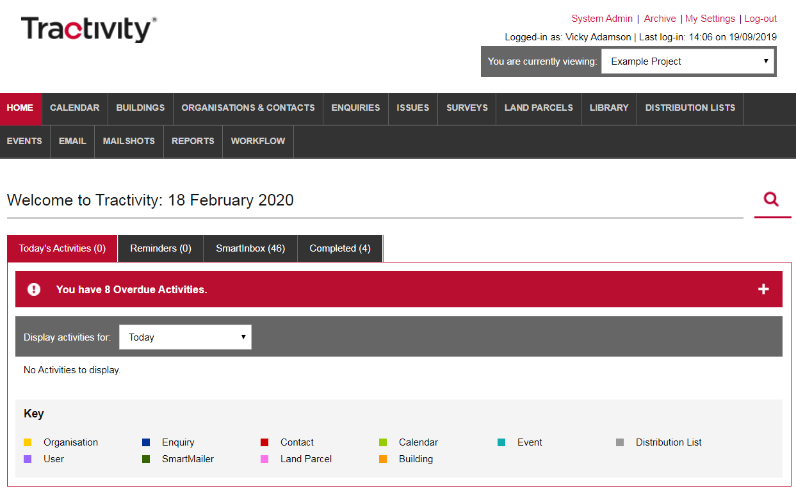
Login to Your Superuser Account
If you are an elected Superuser, access System Admin area of Tractivity through your normal login, via a link shown in the top right-hand corner.
1

Slide 3
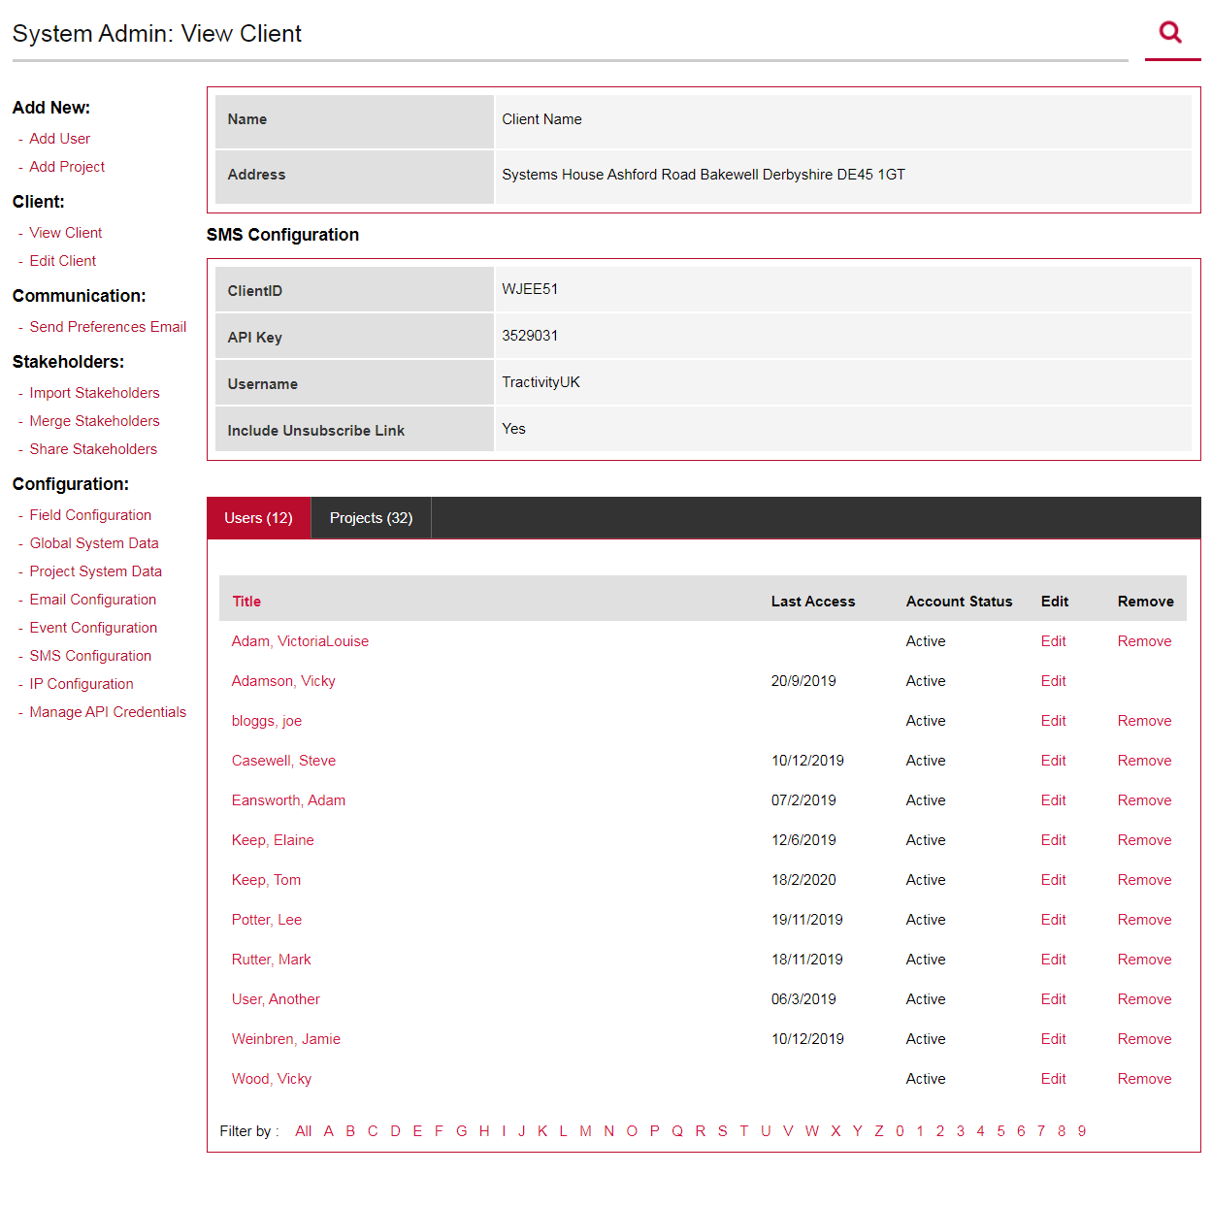
Stakeholders
Inside System Admin, on the left-hand menu under the section titled Stakeholders, you can:
Import Stakeholders
Merge Stakeholders
Share Stakeholder
1

Slide 4
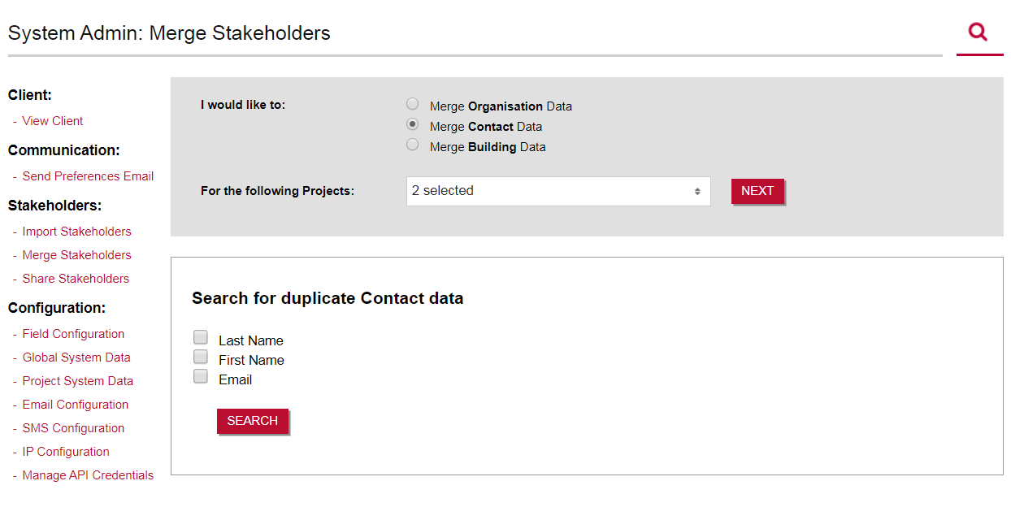
Merge Stakeholders
Great way to manage duplicated data.
Select to check for duplications Organisation, Contact or Building Data?
Do you wish to check multiple projects?
Tick to search for duplications based on: Last Name, First Name or Email Address.
1
2
3

Slide 5
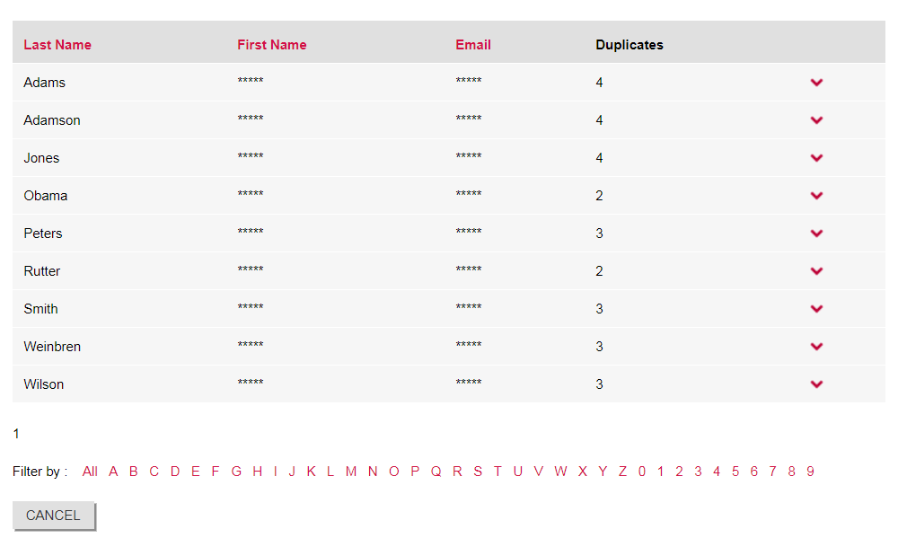
Merge Stakeholders
In the example below, Last Name was selected.
A list of all possible duplicated entries.
The amount of possible duplications.
Expand to view each of the contacts
3
2
1

Slide 6
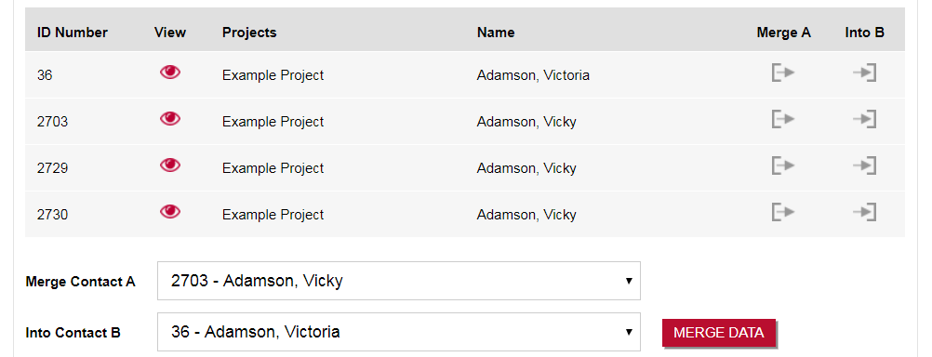
Merge A to B
When merging stakeholders, decide which of the duplicated records is the master record – the one you wish to keep! All records will then be merged into the master record.
For example – ID Number 36 will become the Master Record. All others ID’s 2703, 2729, 2730 will be merged into the Master Record.
Please Note - the merge cannot be reversed.
2
1
3
2

Slide 7
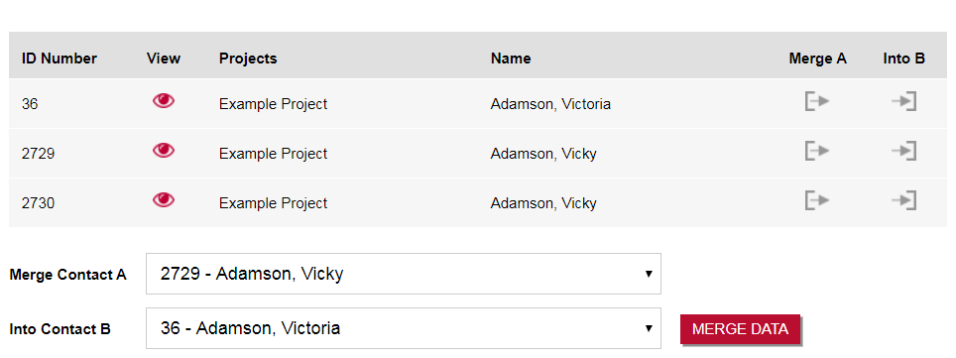
Merge A to B
The screen automatically updates:
Keep Merge A - to B until your left with just the master record.

Slide 8
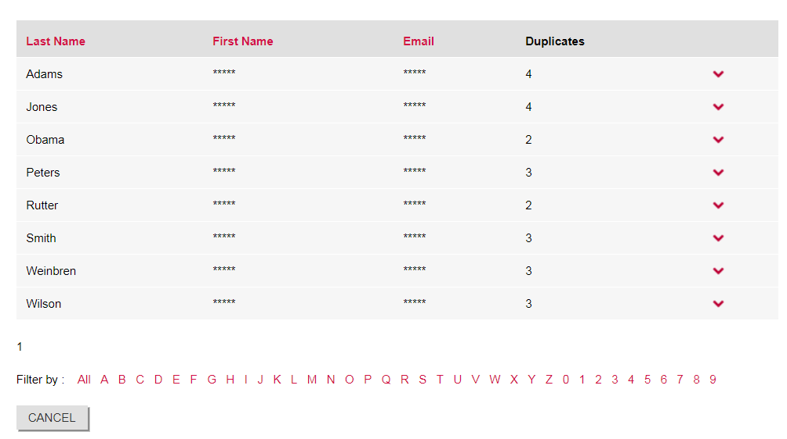
Complete!
Once complete, you will see a list of all other duplicated records.

Slide 9
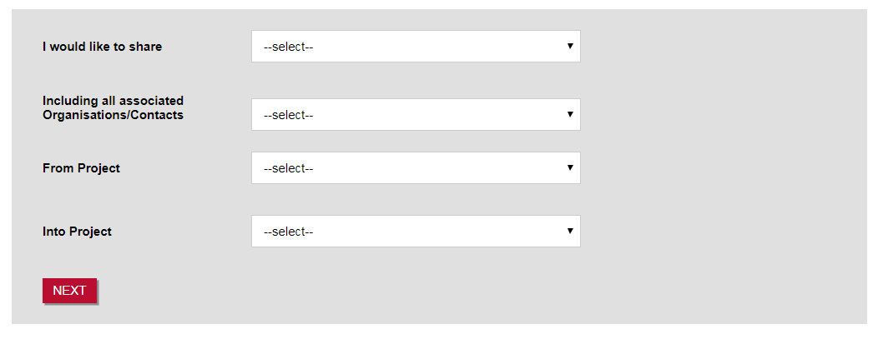
Share Stakeholder
Share Stakeholders is a great tool, especially when creating a new project.
Click Share Stakeholders, from the left-hand menu.
Select to share either Contacts or Organisations
Including all associated means; should an Organisation have 2 Contacts linked, these will also be shared. Same process for Contacts, when a contact is linked to an Organisation, selecting Yes here will ensure all linked Organisation are shared.
Select the Project, you wish to take data from
Select the Project, you wish to add the data too.
2
3
4
5

Slide 10
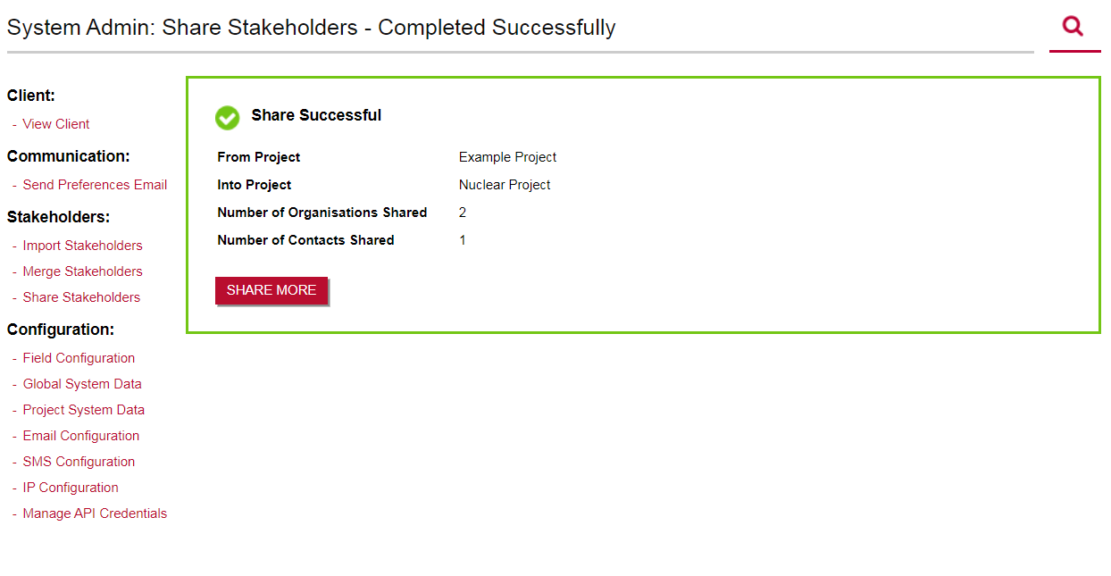
Share Stakeholder
You will be notified once the Share is Successful.
Share More, to follow the process again.

Slide 11
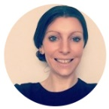
Vicky Adamson
Client Relationship Manager
Systems House, Deepdale Business Park,
Bakewell, Derbyshire, DE45 1GT
www.tractivity.co.uk

