Slide 1

SmartInbox

Slide 2
Managing SmartInbox
View Email Add or find Contact Create or find an enquiry
Attach Email Respond

Slide 3
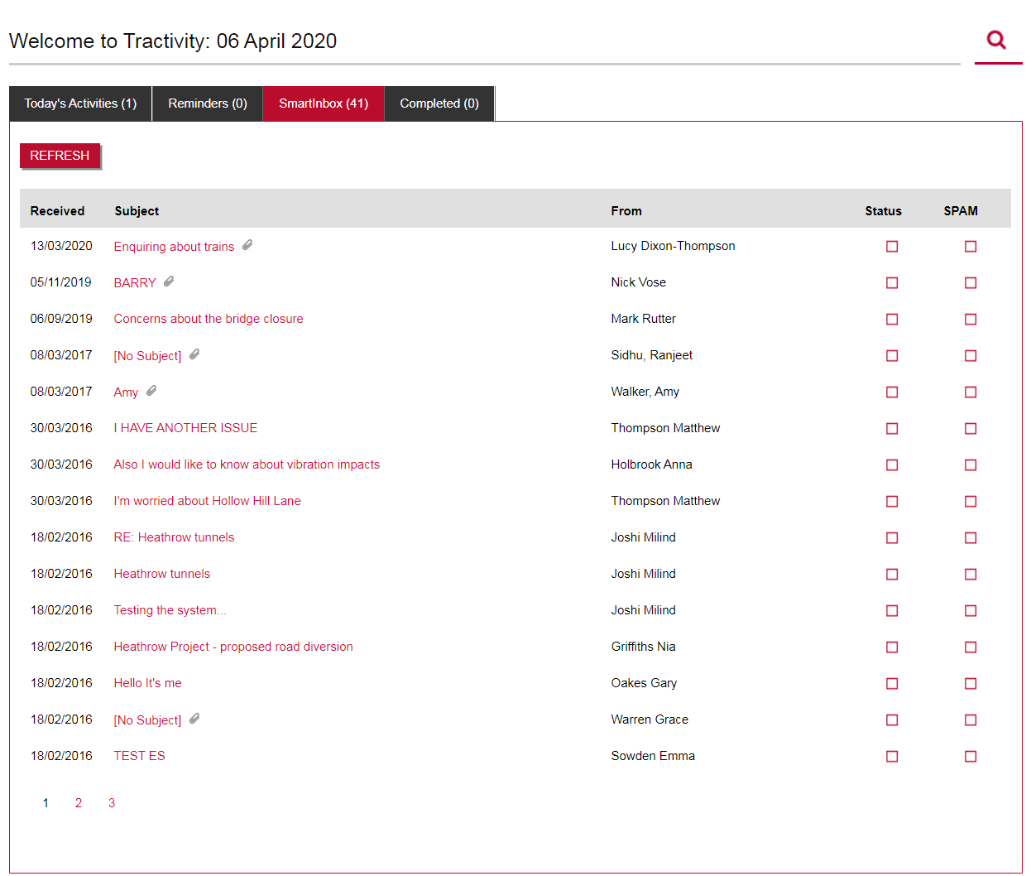
What is SmartInbox?
A shared mailbox is a mailbox that multiple users can use to read and send email messages, these are commonly enquiries@Tractiviy.co.uk or Info@Tractivity.co.uk
Each project inside Tractivity has the capability of having one mailbox displayed on the home screen, providing multiple users easy access to view, record and reply to any emails.
If you would like to setup a SmatInbox for a project, please contact your dedicated Account Manager.
1

Slide 4
To View an Email
The Mailbox runs in real time, allowing you to view emails and respond to your stakeholders straight away.
To view an email click, Subject title.
1

Slide 5
Manage SmartInbox
Each time you view an email within SmartInbox, the system automatically searches your Tractivity database to find matching Contacts or Enquiries based on Email Address (using the From Address) or Enquiry ID (within the email Subject). The next 3 slides will show you all the different options, when you view an email;
No contact is found inside Tractivity, Slide 6
A contact is found inside Tractivity, who has no open enquiries, Slide 7
A contact is found inside Tractivity, who has an open existing enquiry. Slide 8

Slide 6
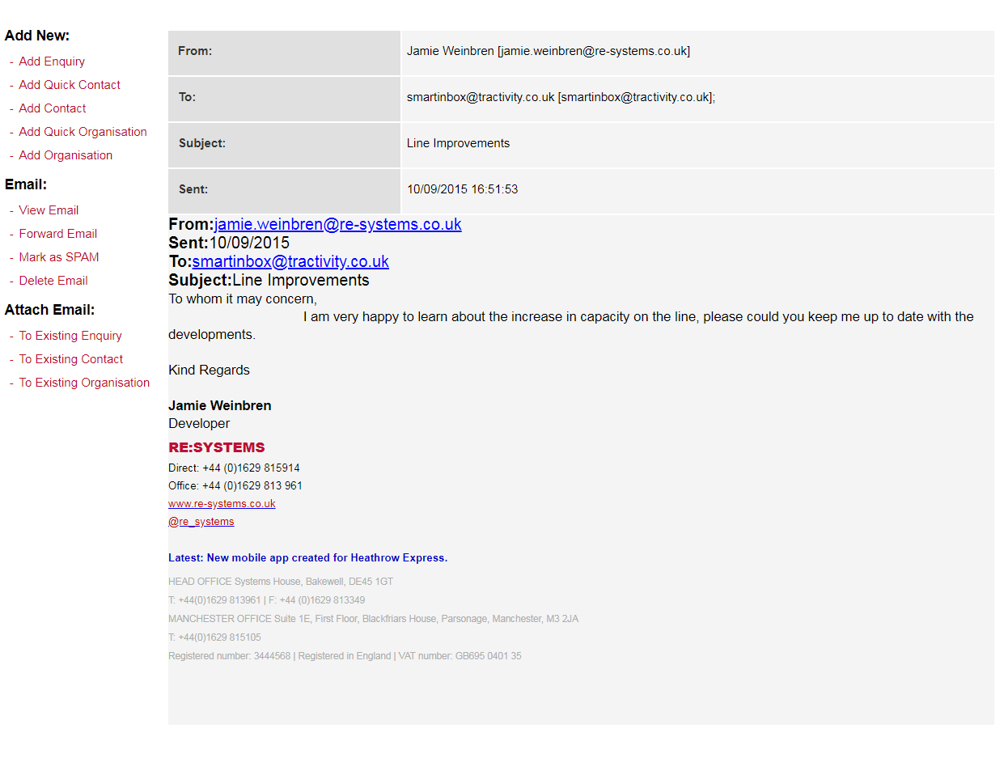
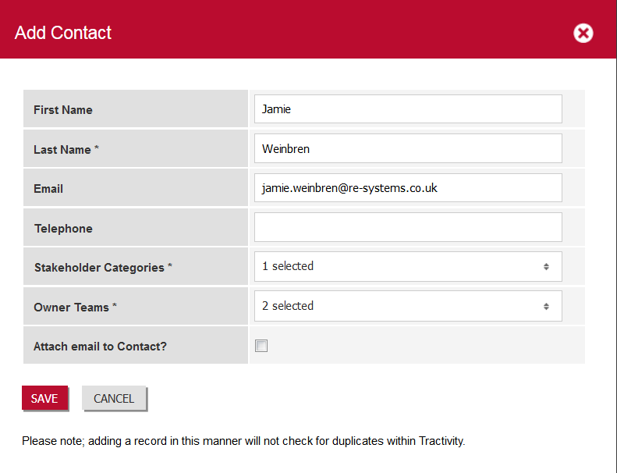
Add New Contact
If no contact is found inside Tractivity you;
Click Add Quick Contact. This allows you to add the stakeholder to your system by populating the minimum amount of information.
Or
2. Click Add Contact. This allows you to add a contact in the same manner as you would normally.
.
1
2
1

Slide 7
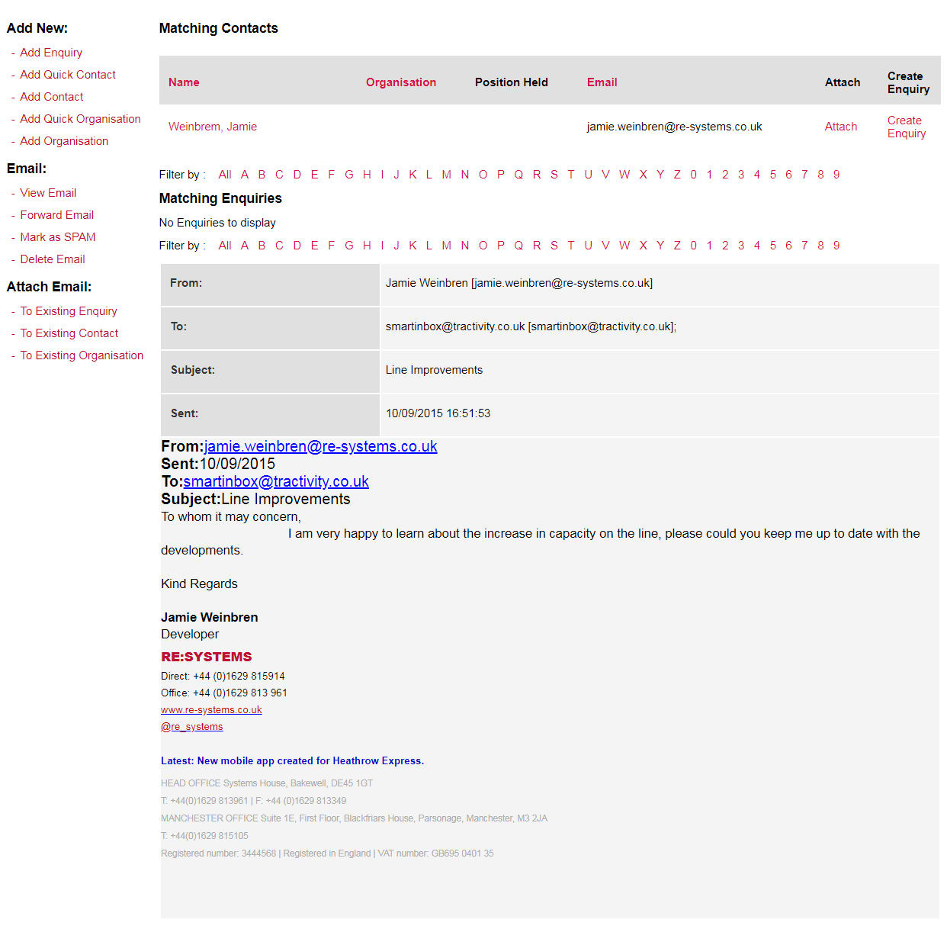
An existing contact, no enquiry.
1
3
2
Matching Contacts, will be displayed here..
Click Create Enquiry.
If you don’t need an enquiry, but wish to record the email inside your system click, Attach. The email will save against the contact.
.

Slide 8
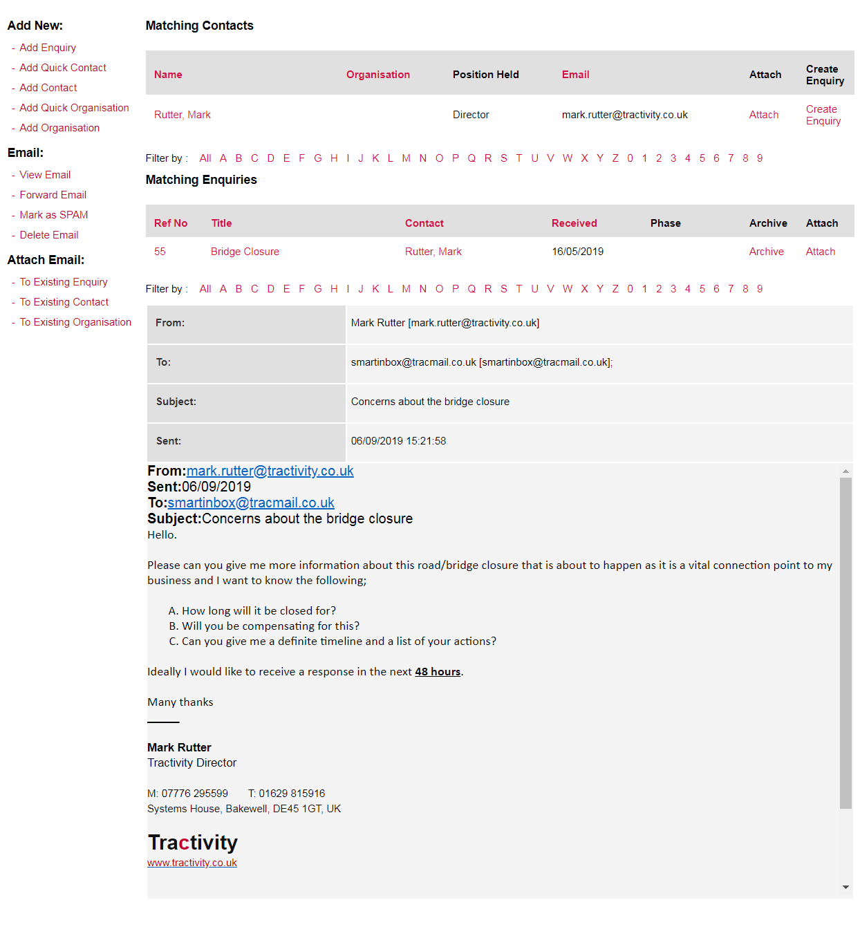
An existing contact with an enquiry.
1
3
Matching Contacts, will be displayed here.
Matching Enquiries, will be displayed here.
You just now need to decide whether to add the email to the existing enquiry, or Add a new Enquiry
3. Click, Add Enquiry, to create a new enquiry.
4. Click, Attach, to add email, to the existing enquiry.
2
4

Slide 9
Status & Spam
Click, Status If you don’t wish to record the email against the contact, great for auto replies or emails which aren't relevant to your project.
Click, SPAM, to block any future emails from this email address. To undo a SPAM, speak with Tractivity Support Team.
1
2

Slide 10
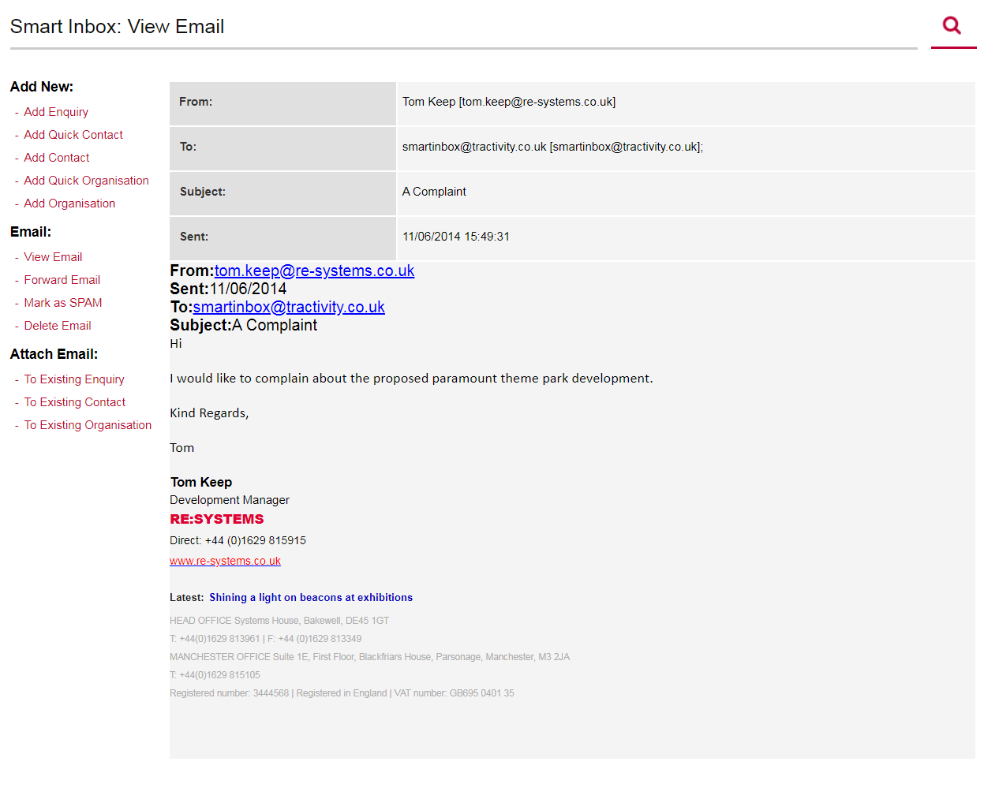
Extra Left-Hand Menu Options
Forward Email, if you wish to forward the email to another user, or stakeholder.
Delete Email, if you wish to remove an email from SmartInbox, then use this link. Please note that this will only remove the Email from Tractivity – it will still remain within the mailbox that Tractivity connects to.
1
1
2

Slide 11

Vicky Adamson
Client Relationship Manager
Systems House, Deepdale Business Park,
Bakewell, Derbyshire, DE45 1GT
www.tractivity.co.uk

