Slide 1

Superuser Manual
Configuration of your Tractivity System

Slide 2
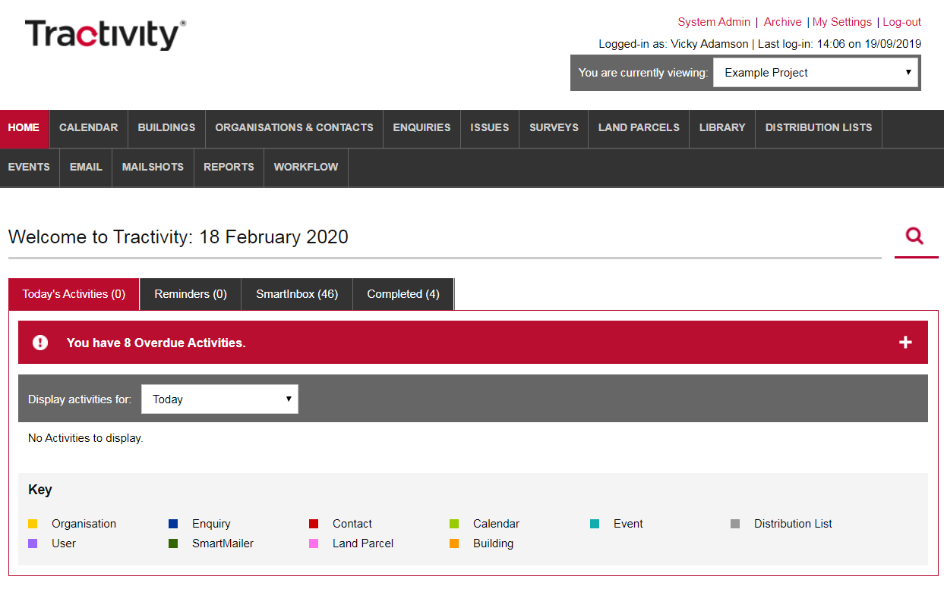
Login to Your Superuser Account
If you are an elected Superuser, you will be accessing the System Admin area of Tractivity, through your normal login, via a link shown in the top right-hand corner.
1

Slide 3
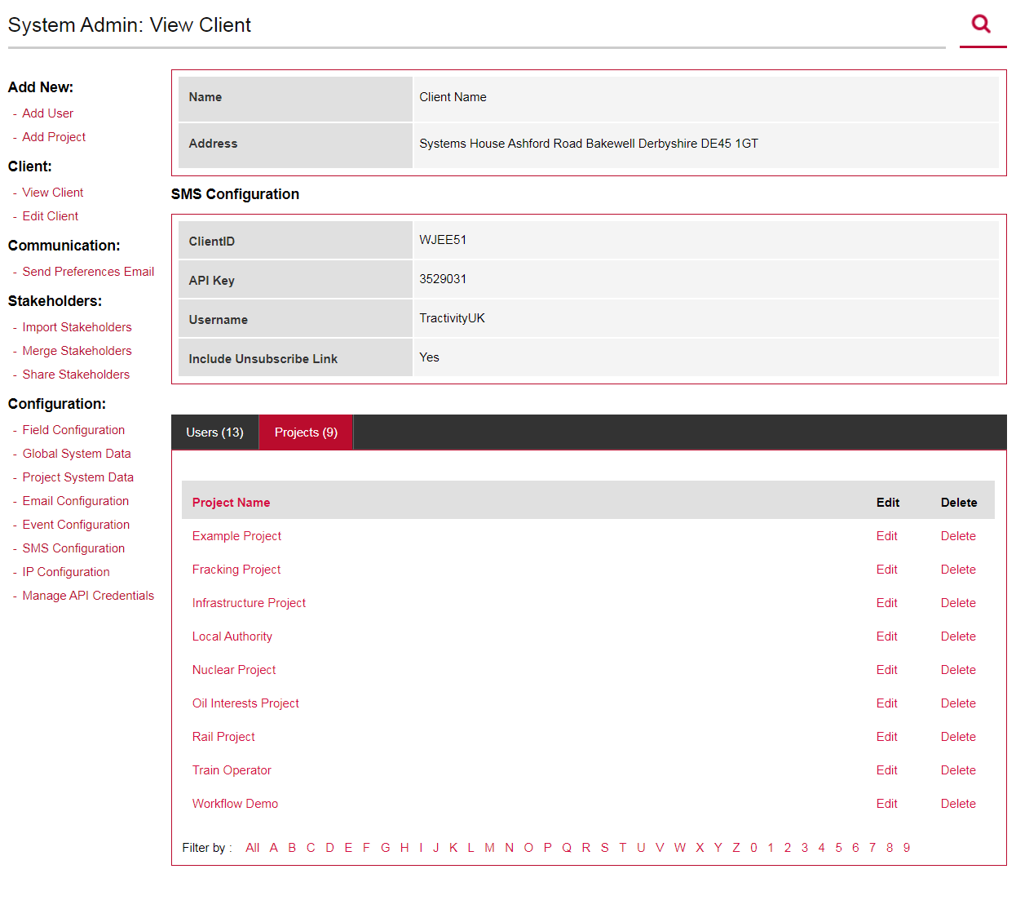
System Customisation
Homepage of the Superuser Area is System Admin: View Client. To return back to the Homepage of the Superuser Area, click System Admin.
Within the homepage you will be able to configure each of your projects using the following left-hand options;
Field Configuration
Global System Data
Project System Data
Email Configuration
Event Configuration
SMS Configuration
IP Configuration
Manage API Credentials
1

Slide 4
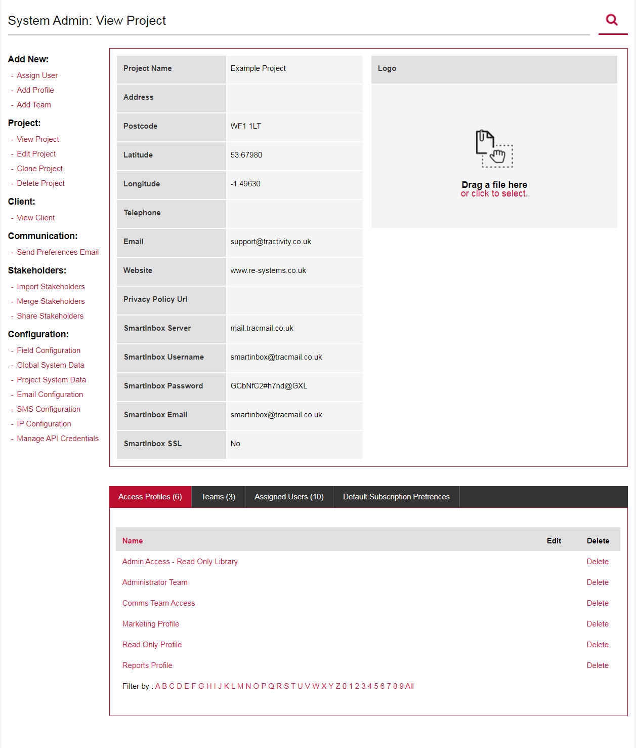
Customise your
Tractivity System
The following three areas, allow you to change your system, at anytime. This include, the information you select to record, any associated drop-down list’s and if it requires to be mandatory .
Field Configuration. Select on a project by project basis, what information you wish to record and if it requires to be mandatory
Global System Data, drop-down lists displayed here are fixed across ALL projects. Meaning the drop-down list will remain the same in Project A, B and C.
Project System Data, drop-down lists displayed in here, are changeable per project.
1

Slide 5
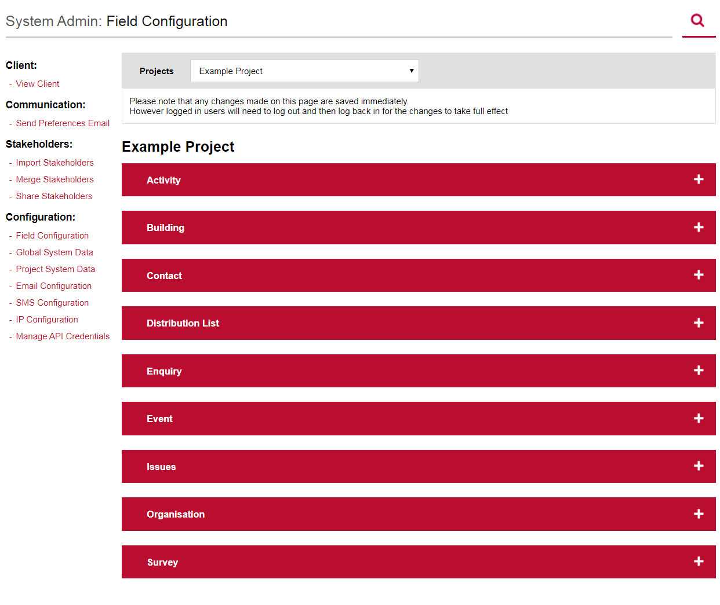
Field Configuration
Allows you to select what information you record inside each ADD Screen inside your Tractivity System.
Click, Field Configuration from the left-hand to review what information you record, on a project by project basis.
Any information you change, will be instantly available inside Tractivity.
Have flexibility of amending a project at anytime.
Select the project.
View each Add Screen inside Tractivity. Click + icon to view
1
2

Slide 6
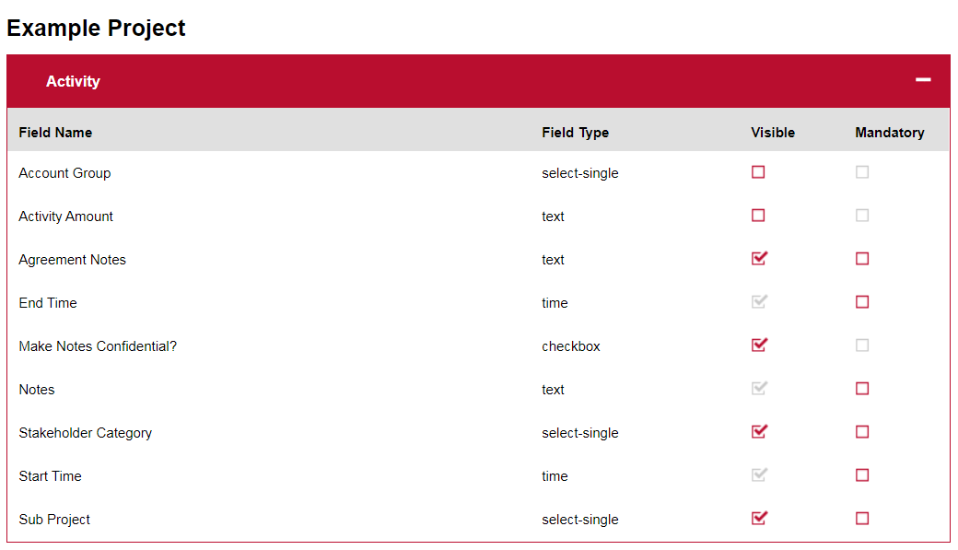
Field Configuration
Expand a section, to view what information you can record.
Visible, ability to hide/un-hide information.
Mandatory, make information compulsory. Useful should you wish to make sure users enter key information.
1
2

Slide 7
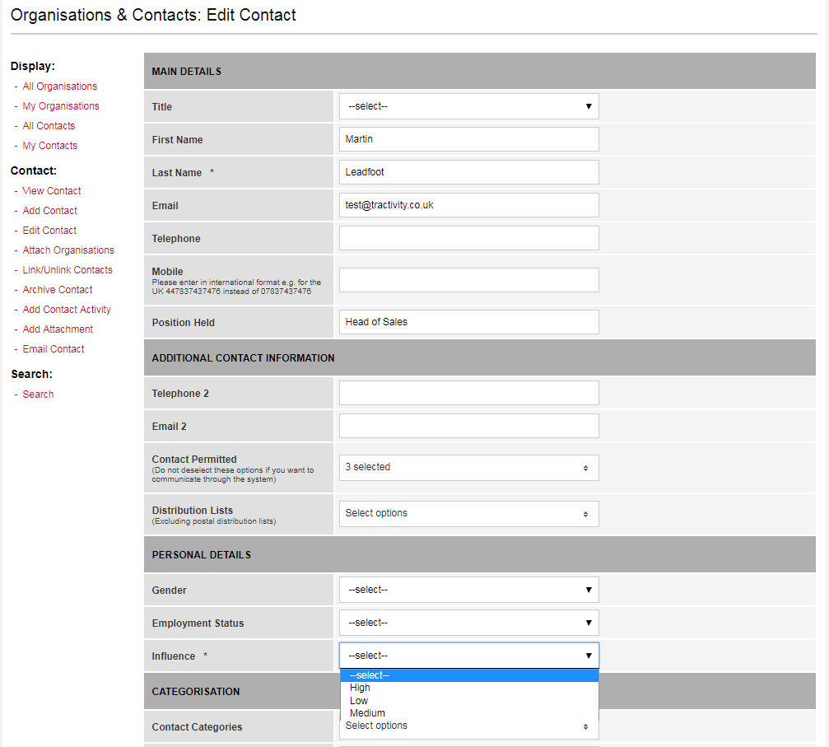
Changing Drop-down
List’s
Now you have selected the information you wish to record, you can review the drop-down options. Drop-down menu options have been divided into two sections on the left-hand menu:
Global System Data, drop-down lists that appear here, are fixed across all your projects.
Project System Data, drop-down lists that appear here, can be amended on a project by project basis.
1

Slide 8
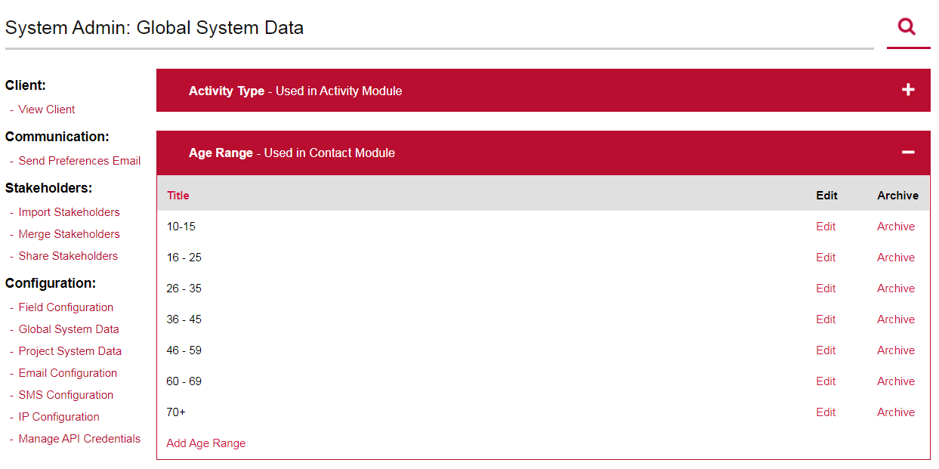
Global & Project System Data
To amend a drop-down list, follow please remember to select your project first if you are inside Project System Data:
Edit, meaning any associated contact will remain attached but you are simply amending the value.
Archive, any associated contact will still have this value displayed but you want be able to search for this inside the search boxes or reports filters and the value will no longer appear in the drop-down list.
Add Age Range, add a new value to your drop-down list.
1
2
3

Slide 9
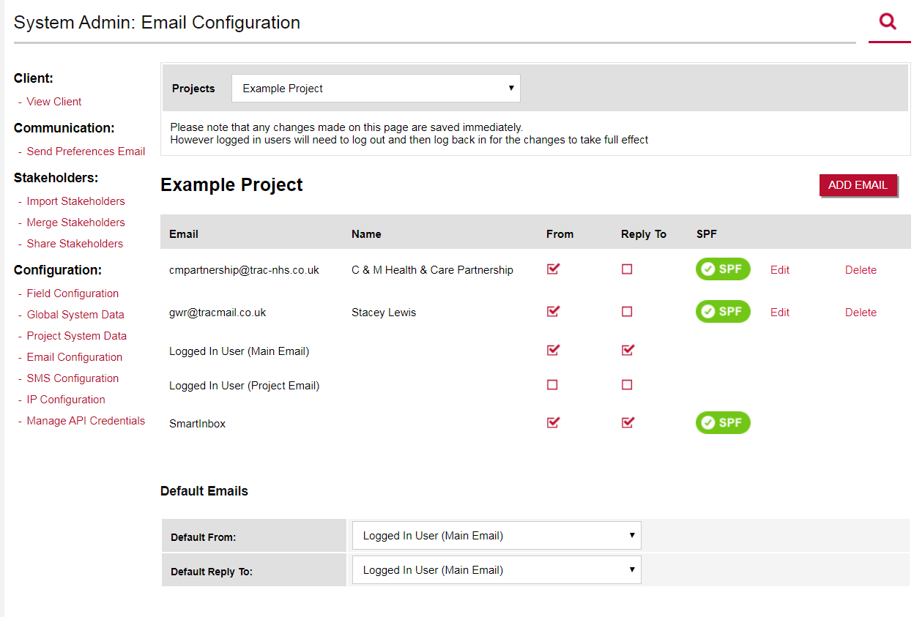
Email Configuration
Add central mailbox addresses to projects, such as comms@tractivity.co.uk or info@tractivity.co.uk:
Select your Project, first.
Click, Add Email to add a new email address and add a linked from name.
Select whether you wish the email address to be used as a from & Reply to address.
SPF, when setting up Tractivity your IT team were asked to setup an SPF record, which allows our system to send emails on your behalf without the receiver thinking we are SPAM. Please speak with your Account Manager, should the icons be amber and you require some more information.
Edit or Delete any existing email address
Set default Emails addresses for all users
1
2
3
4
5
6

Slide 10
SMS Configuration
Tractivity can send SMS to all your stakeholders, we integrate with a product called Clickatell.
https://www.clickatell.com/
1
2
3
4
5
6

Slide 11
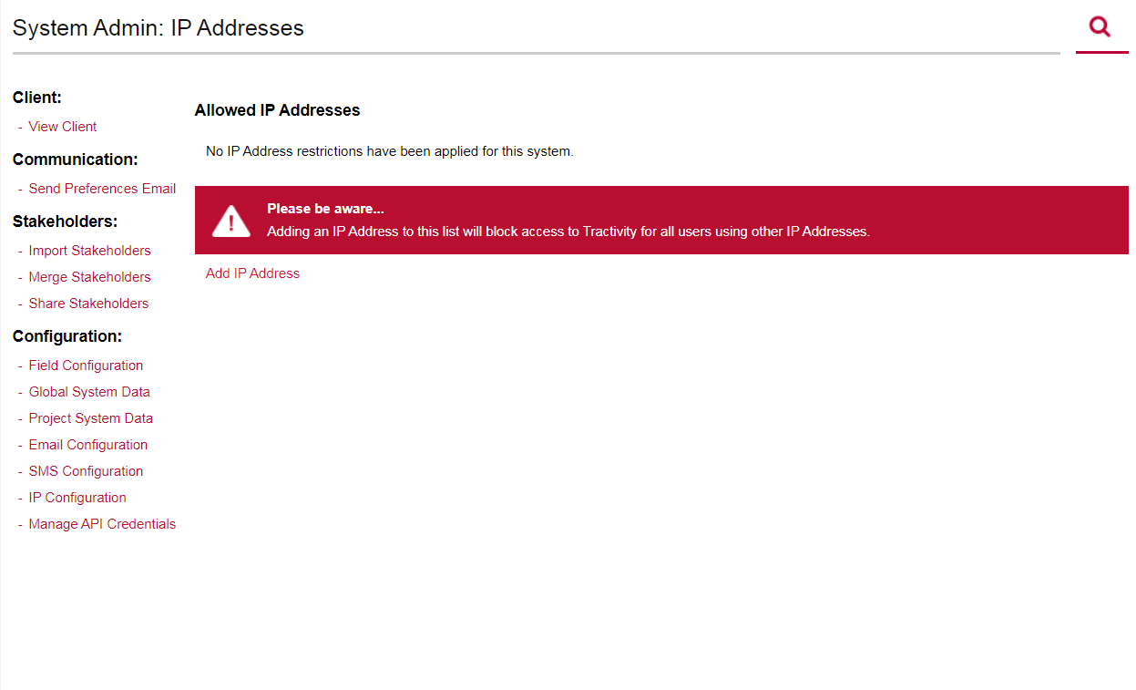
IP Configuration
You can restrict access to Tractivity based on your known IP Addresses.
Should your IT team require you to only have access to Tractivity whilst in the office you can add your known IP addresses here.
Please Note - should you require to work from home, or whilst on the move (train, café) then this will restrict your access.

Slide 12
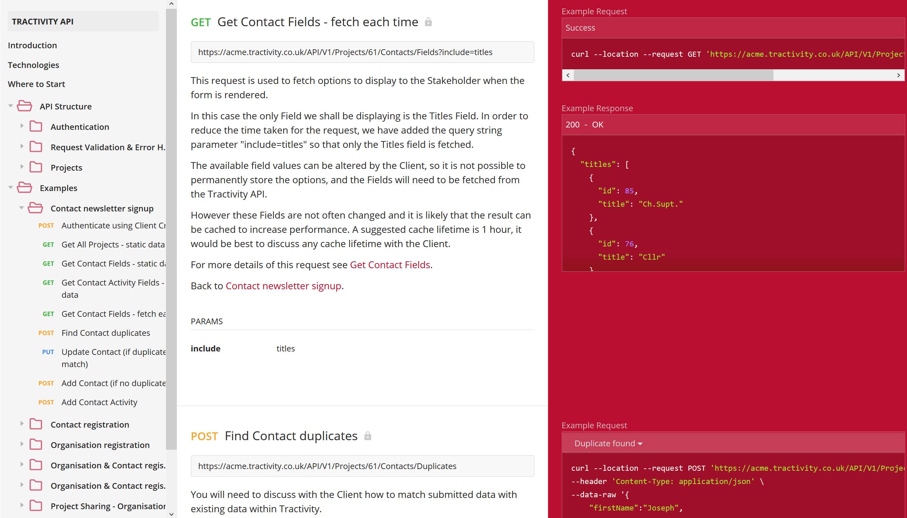
Manage API Credentials
This area of your system wont be used buy yourself – but more often than not your website team.
Capture stakeholder details inside registration forms, newsletter sign up’s, advertise & manage event registrations via our AP. The API acts as a bridge between your website and Tractivity.
Furthermore, Its completely free, so why not send our API documentation to your web team, to see what they can do? https://apidocumentation.tractivity.co.uk
Please kindly note that your web team will need to know quite a lot of information about how you record information inside Tractivity – why not call your Account Manager to talk this though in more detail.

Slide 13

Vicky Adamson
Client Relationship Manager
Systems House, Deepdale Business Park,
Bakewell, Derbyshire, DE45 1GT
www.tractivity.co.uk

