Slide 1

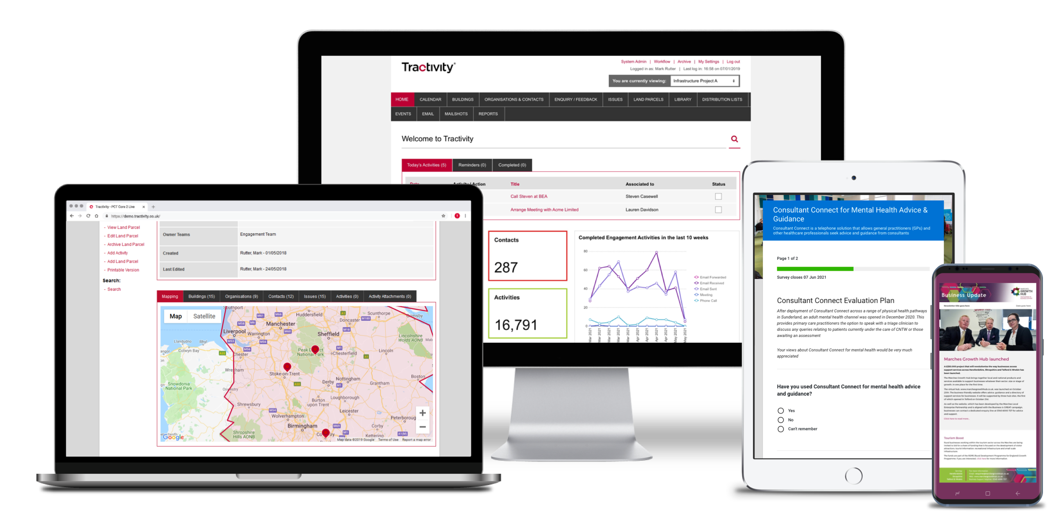

You Said,We Did!

Slide 2
A look back at
June’s event

Slide 3
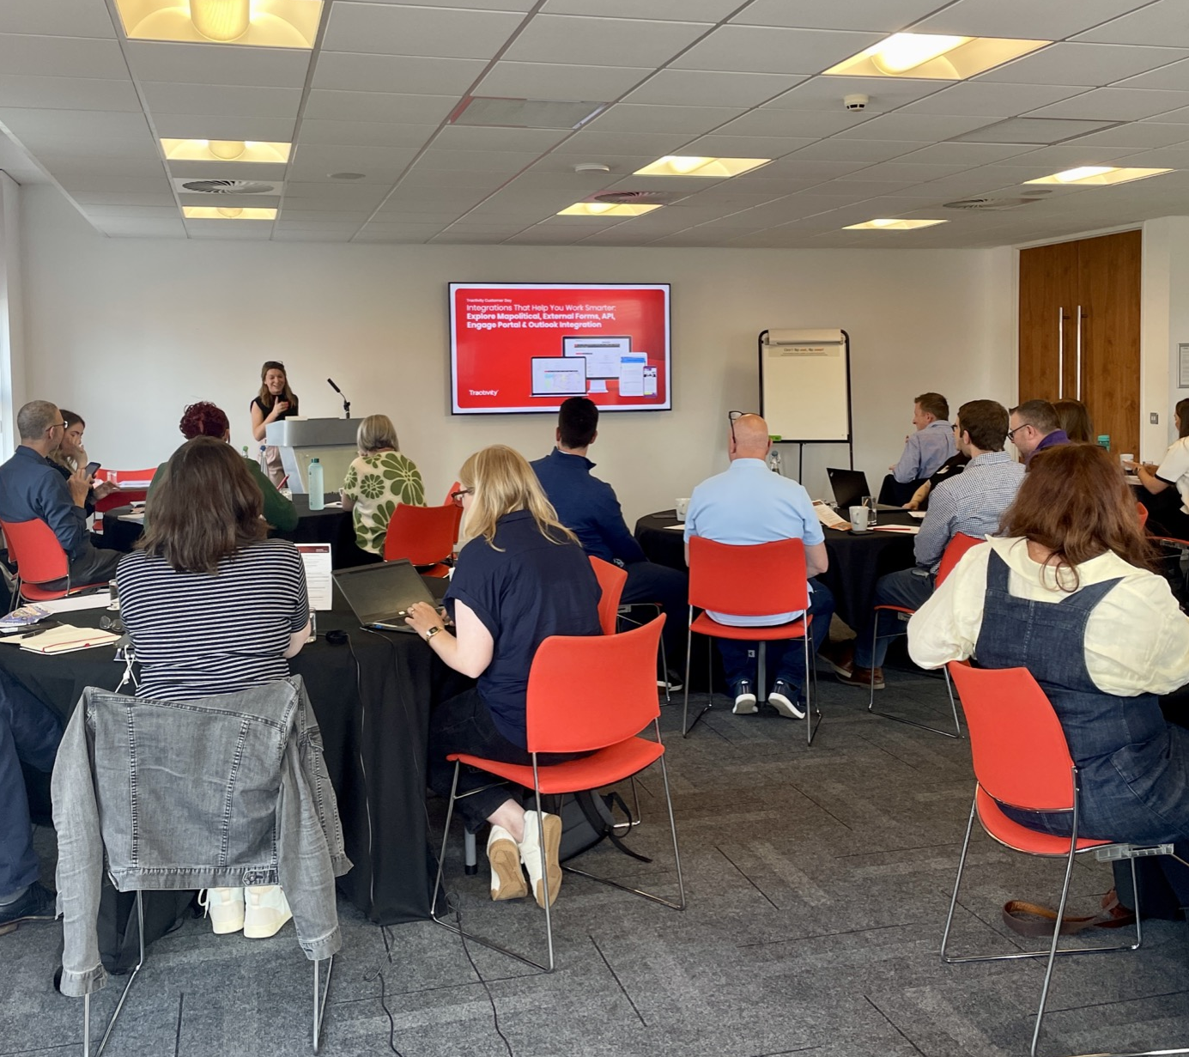
June Customer Event
Our first-ever Customer Event – June 2025
Successfully hosted our first customer event
Showcased system enhancements, including the Tractivity upgrade and new A.I.-powered features
Engaged directly with users to gather valuable feedback on key areas for future improvements

Slide 4
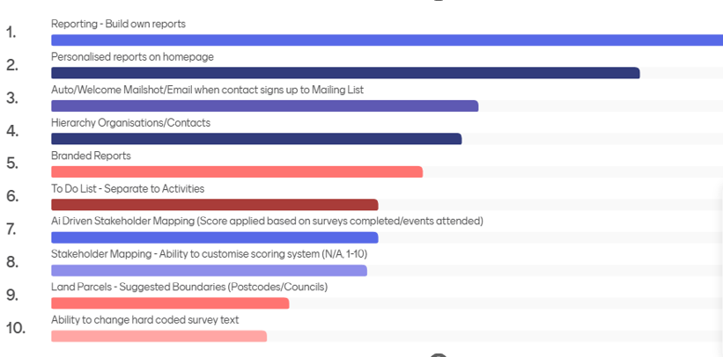
Your Feedback
Key takeaways from the event:
1. Priority Areas Identified
Participants highlighted several areas for improvement.
Reports module ranked as the top priority.
2. User Insights Gathered
Shared ideas on how to enhance the Reports module.
Discussed current challenges and pain points.
Suggested ways to make reports more flexible, intuitive, and insightful.

Slide 5
Report – Focus Group
Ability to build & customise reports
Next steps:
Consolidate user feedback & define improvement roadmap for the Reports module including:
Greater flexibility to select fields within reports
Faster, simpler report generation
Ability to build and customise reports
Option to create personal report suites
More visual and interactive reporting features
Greater flexibility to select fields
Create personal report suites
Faster, simpler report generation
More visual & interactive reporting
features

Slide 6
Reports module enhancements

Slide 7
Our Next Steps
Enhanced Reporting module
Two major changes
We’re focusing improvements in two key areas:
Enhanced Reporting Module
More flexible, intuitive, and insightful reports
Enhancing Data Export
Enhance the current Export Results feature.
Enhanced Data Export

Slide 8




Reports Module
Reports module enhancements
We’re in the early stages of overhauling the Reports module, but we already understand the key improvements you, our users, want to see:
More visual graphs and charts
Ability to build your own reports
Greater flexibility and control
More user-friendly

Slide 9

Reports Module
Reports module enhancements
We are reviewing all available options for enhancements.
One option, still in early research, includes potential Power BI integration.
We aim to provide an update on the future direction of the Reports module before year-end.

Slide 10
Enhanced Data Export
Positives | User-Requested Extras
Easy to use | Increase amount of data you can export
Add own filters | Select what fields appear in the export
Export quickly | Ability to share within the system with other users
Don’t need to use reporting module | Extend to other modules
Reports: Direct from modules
We have decided to expand the current Export Results feature based on feedback from the customer day.

Slide 11
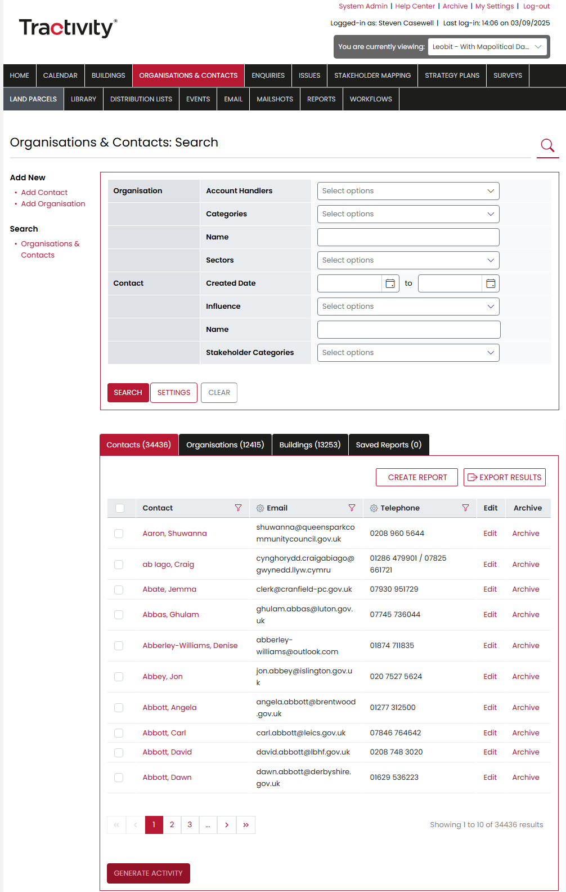
Enhanced Data Export
Organisations & Contacts export results
We will change the current Export feature:
The new system will only export the fields selected and displayed on screen.
Meaning instant exports, with no restrictions on quantity data.
Tick all contacts or specific contacts and click Export Results.

Slide 12
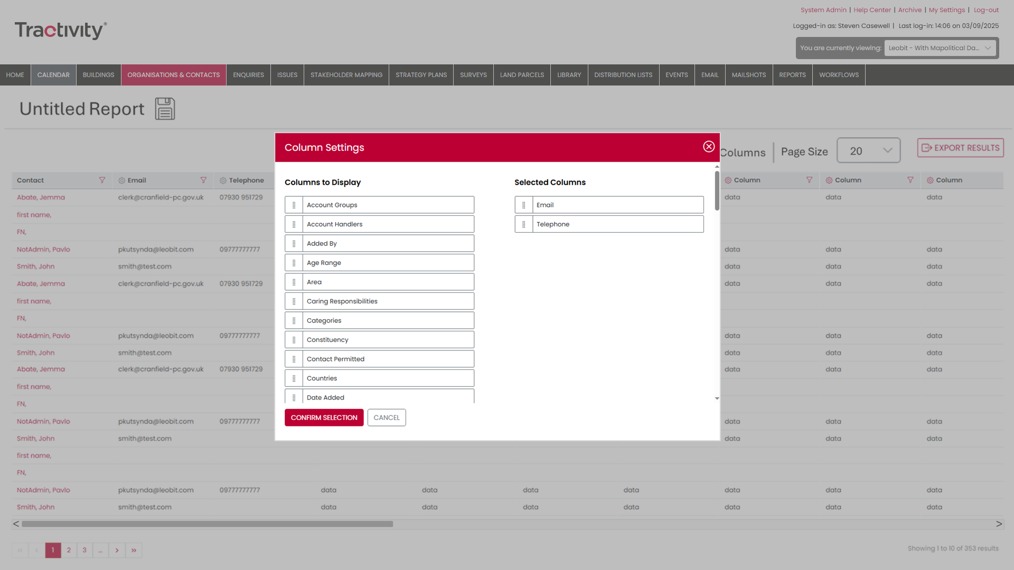
Enhanced Data Export
Extra features you’ll love
Need more than three rows of data? Simply click Create Report.
Add any additional information you want included in your report.
Drag & drop to arrange and confirm exactly what you want to see.

Slide 13
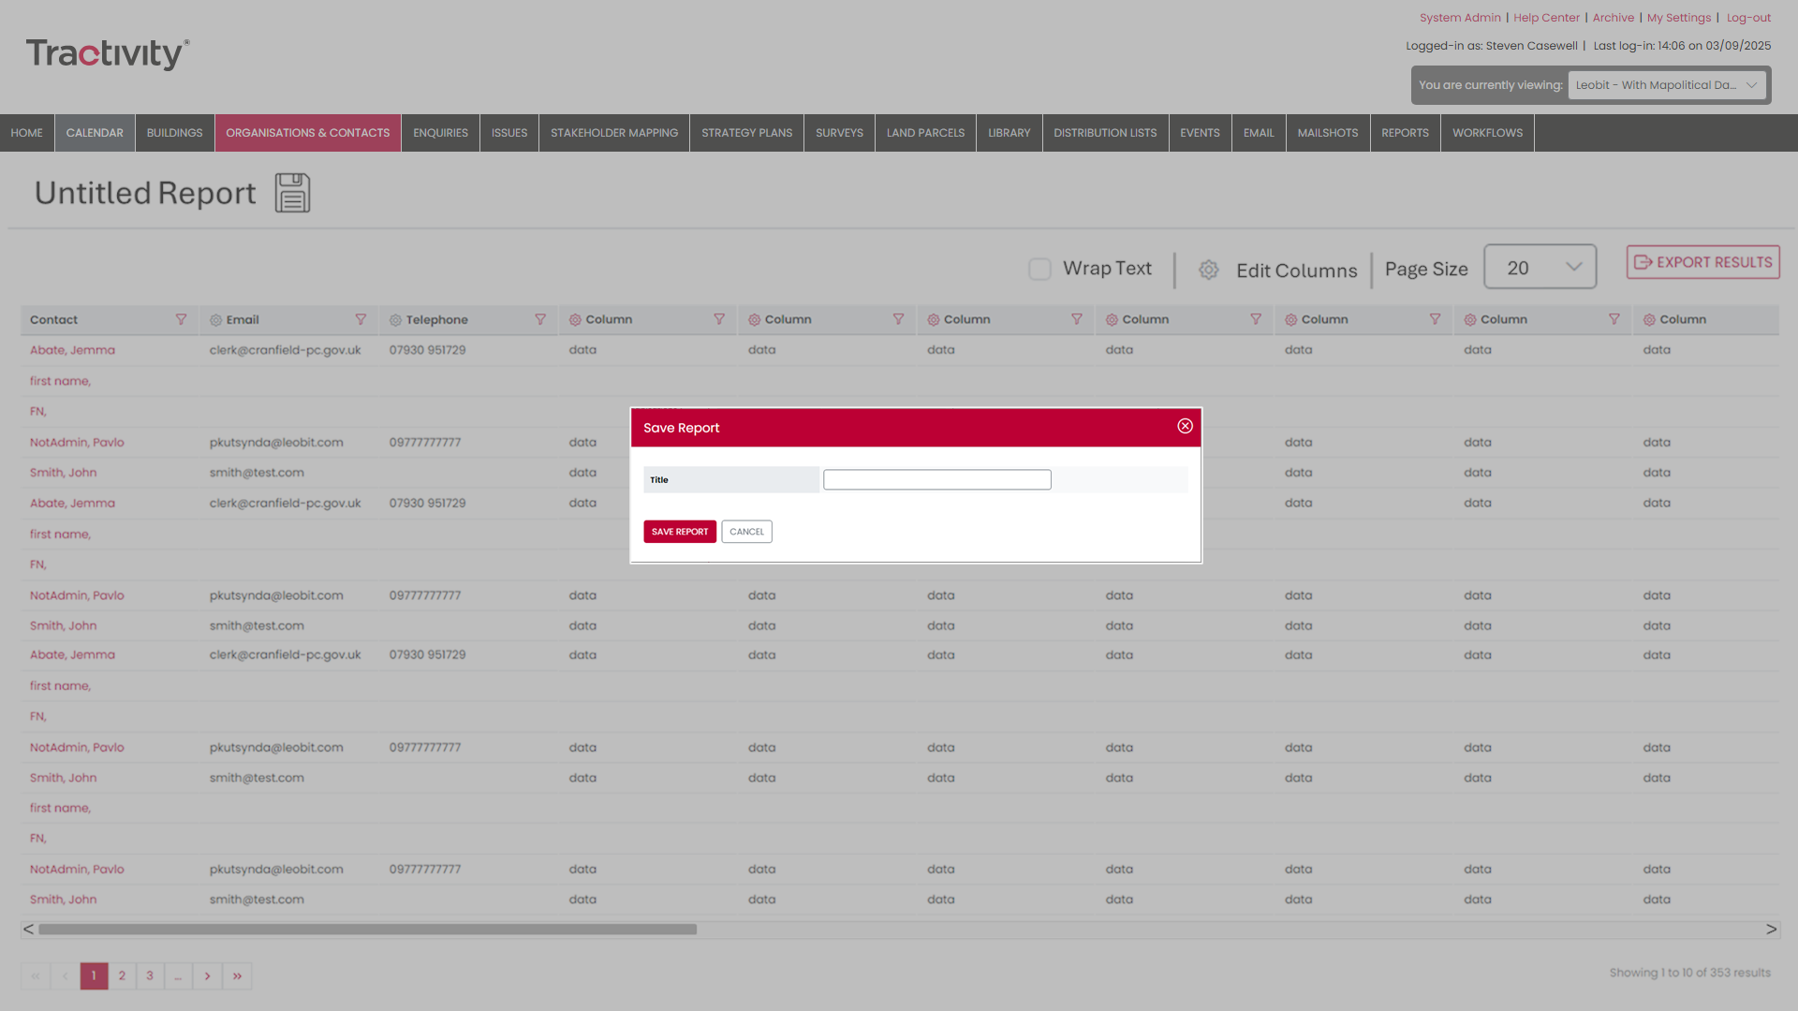
Enhanced Data Export
Save for you and your team
Save: Keep your work handy so you and your team can access it anytime.
Share: Send reports to other users instantly—no need for duplicate work.
Control Access: Set user permissions to allow others to view or edit, keeping your data secure and organised.

Slide 14
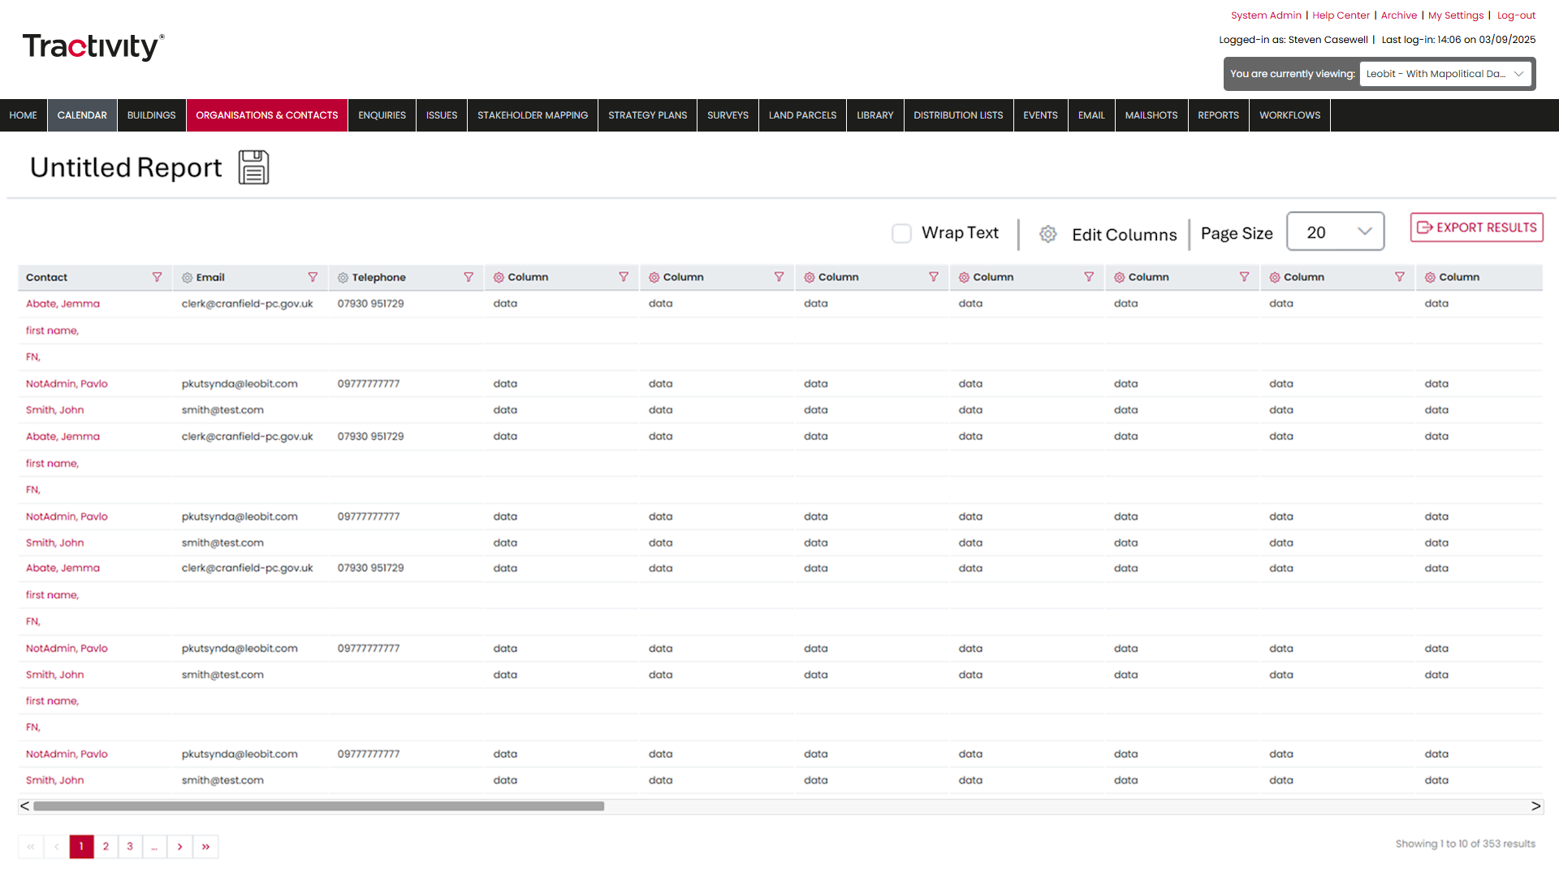
Improved Report Creation Experience
Full-width view
When creating a report, the screen now expands to full width.
This ensures you can view all columns clearly before exporting.

Slide 15
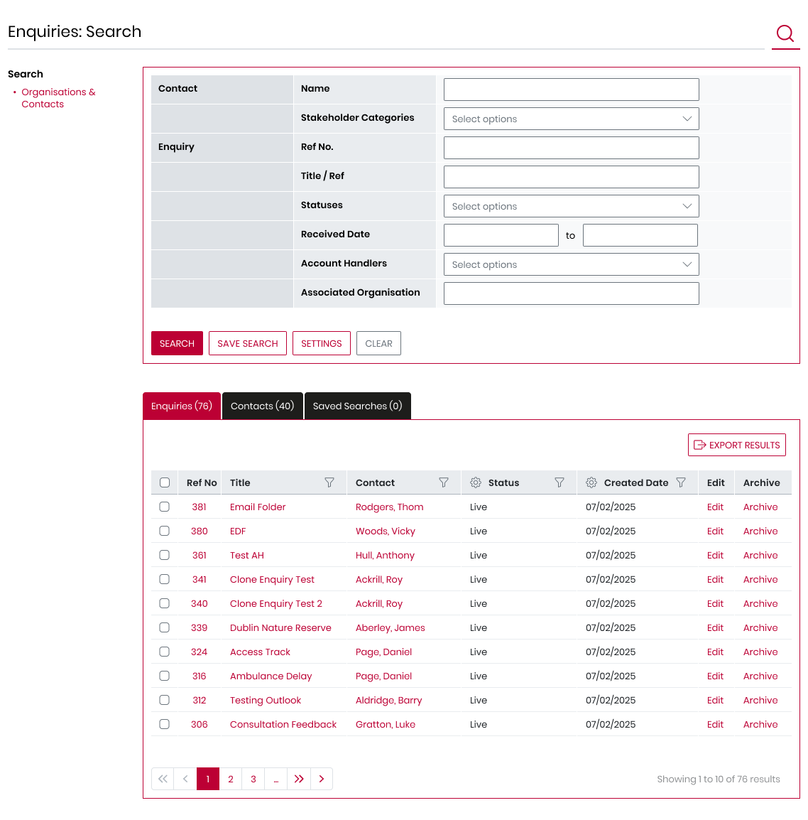
Enquiry Data Export
Export Enquiry data
We haven’t stopped there — your Enquiries screen now includes the same powerful features as your Reports:
Search & Filter: Quickly find the enquiries that matter most.
Export Reports: Download enquiry data instantly for further analysis or sharing.
Why this matters:
Saves time by letting you access exactly the data you need
Makes reporting and decision-making faster and more efficient

Slide 16

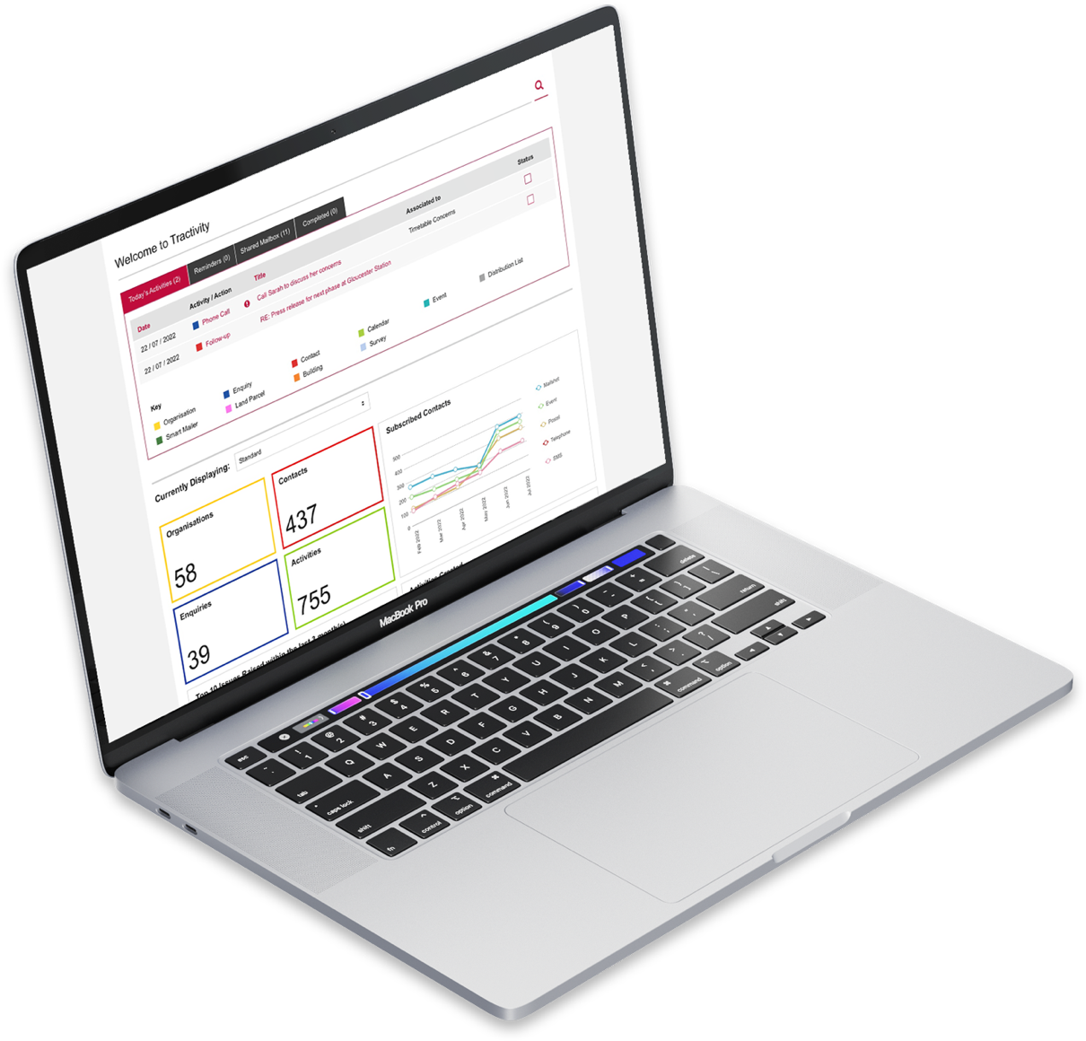



New Activity Module – Coming Soon
Track and export all core interactions
A new Activity module will be available in the black navigation bar, giving you full control over your interactions:
Search: Quickly find any activity across your system.
Filter: Locate specific activities with ease.
Export: Download activity data instantly for analysis or sharing.
Create Reports: Generate activity reports tailored for you and your team.

Slide 17
Thank you

Slide 18




Tractivity Customer Day
A Look at the Tractivity Roadmap:
Innovating for a smarter, faster, and more accessible future...
2024
2026

Slide 19
The Front-End Refactor
Speed
Accessibility Standards
From February 2025 - Front-end rebuild
Transitioning our platform to Microsoft’s latest web technology.
Benefits:
Faster, smoother performance
Enhanced user experience
Aligned with latest WCAG 2.2 AA accessibility standards
Modern, future-proof platform interface
Future scalability
Mobile Accessible
Adaptive to screen size
Different Time zones
Multi-Lingual
Notes:
Future proof – Full-width view
Potential to be multi-lingual (Language Packs)

Slide 20
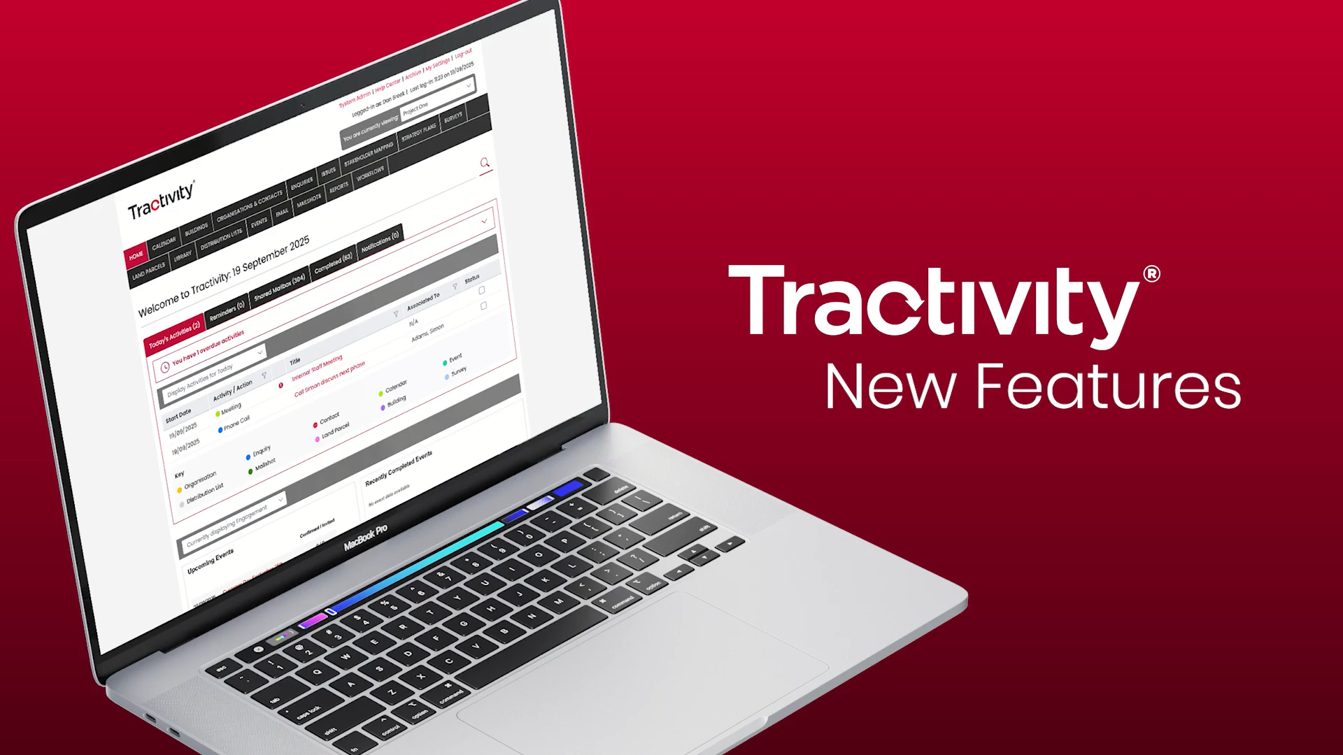
Notes:
Future proof – Full-width view
Potential to be multi-lingual (Language Packs)

Slide 21
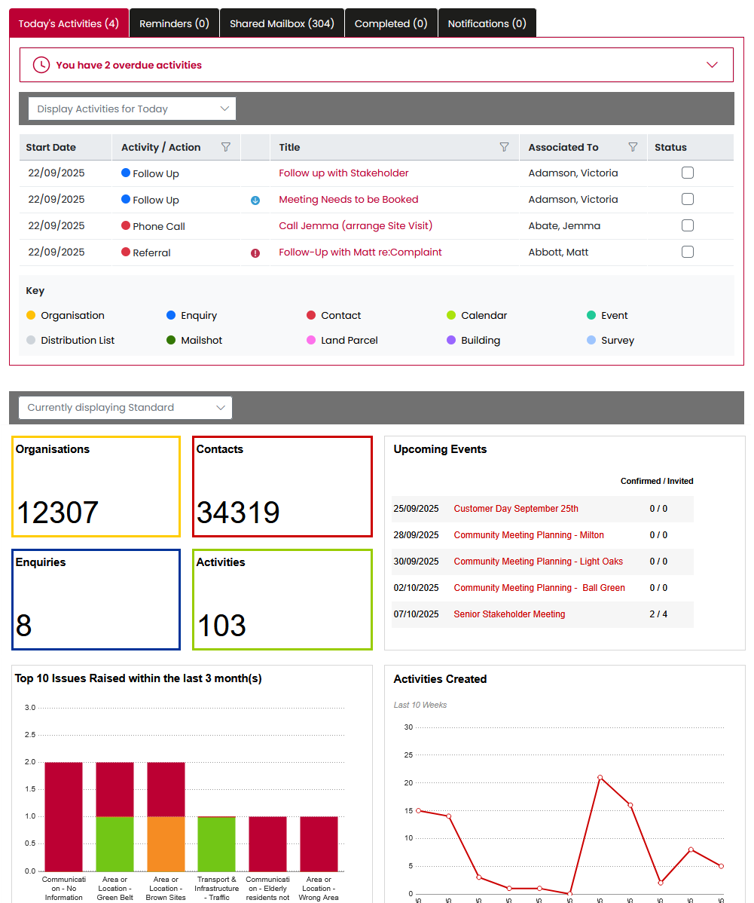
Sneak Preview – Home screen
Module-by-module approach
Designed with consistency in mind.
Subtle style changes have been made:
Rounded tabs
Filter columns
Colour scheme tweaks

Slide 22
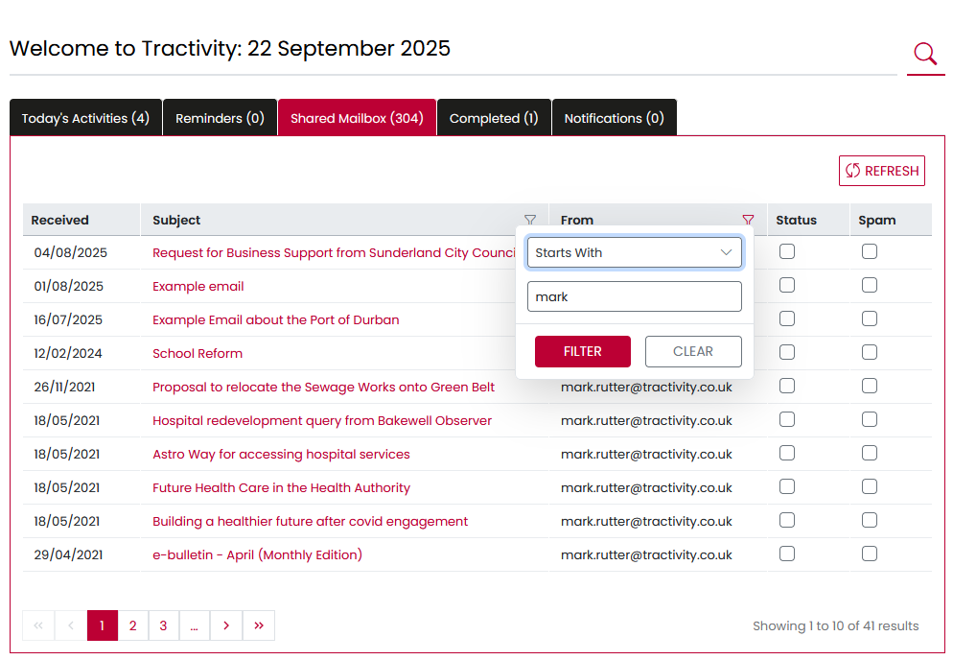
Sneak Preview – Shared Mailbox
New Shared Mailbox interface
Ability to sort on Subject, Received Date and From Recipient.
Search through your entire inbox using the new filter function.

Slide 23
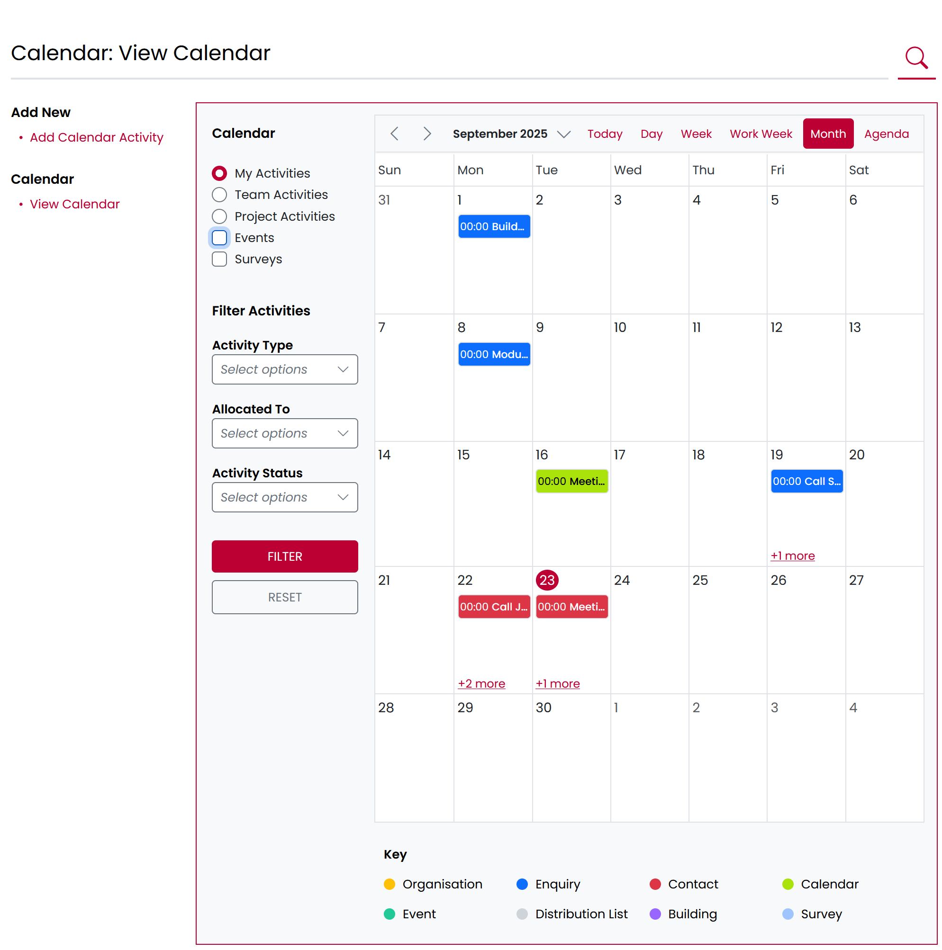
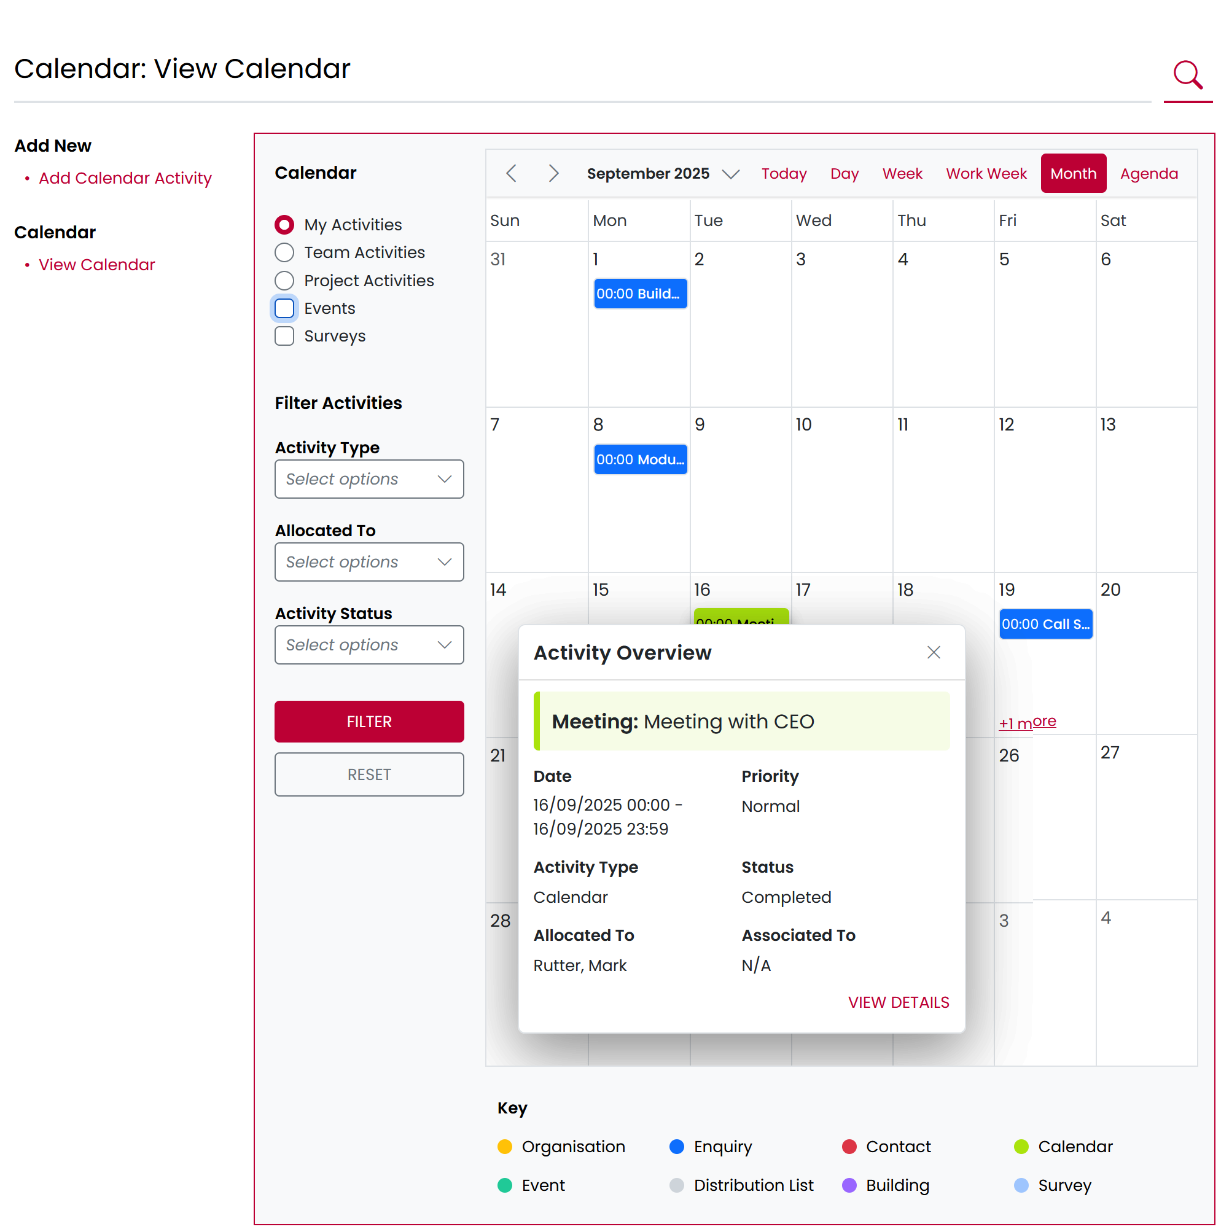
Sneak Preview – Calendar (Overview)
New Calendar Interface
Display multiple Activities, Events & Surveys
Ability to filter by User, Team, Date and Type
Ability to read & access each interaction

Slide 24
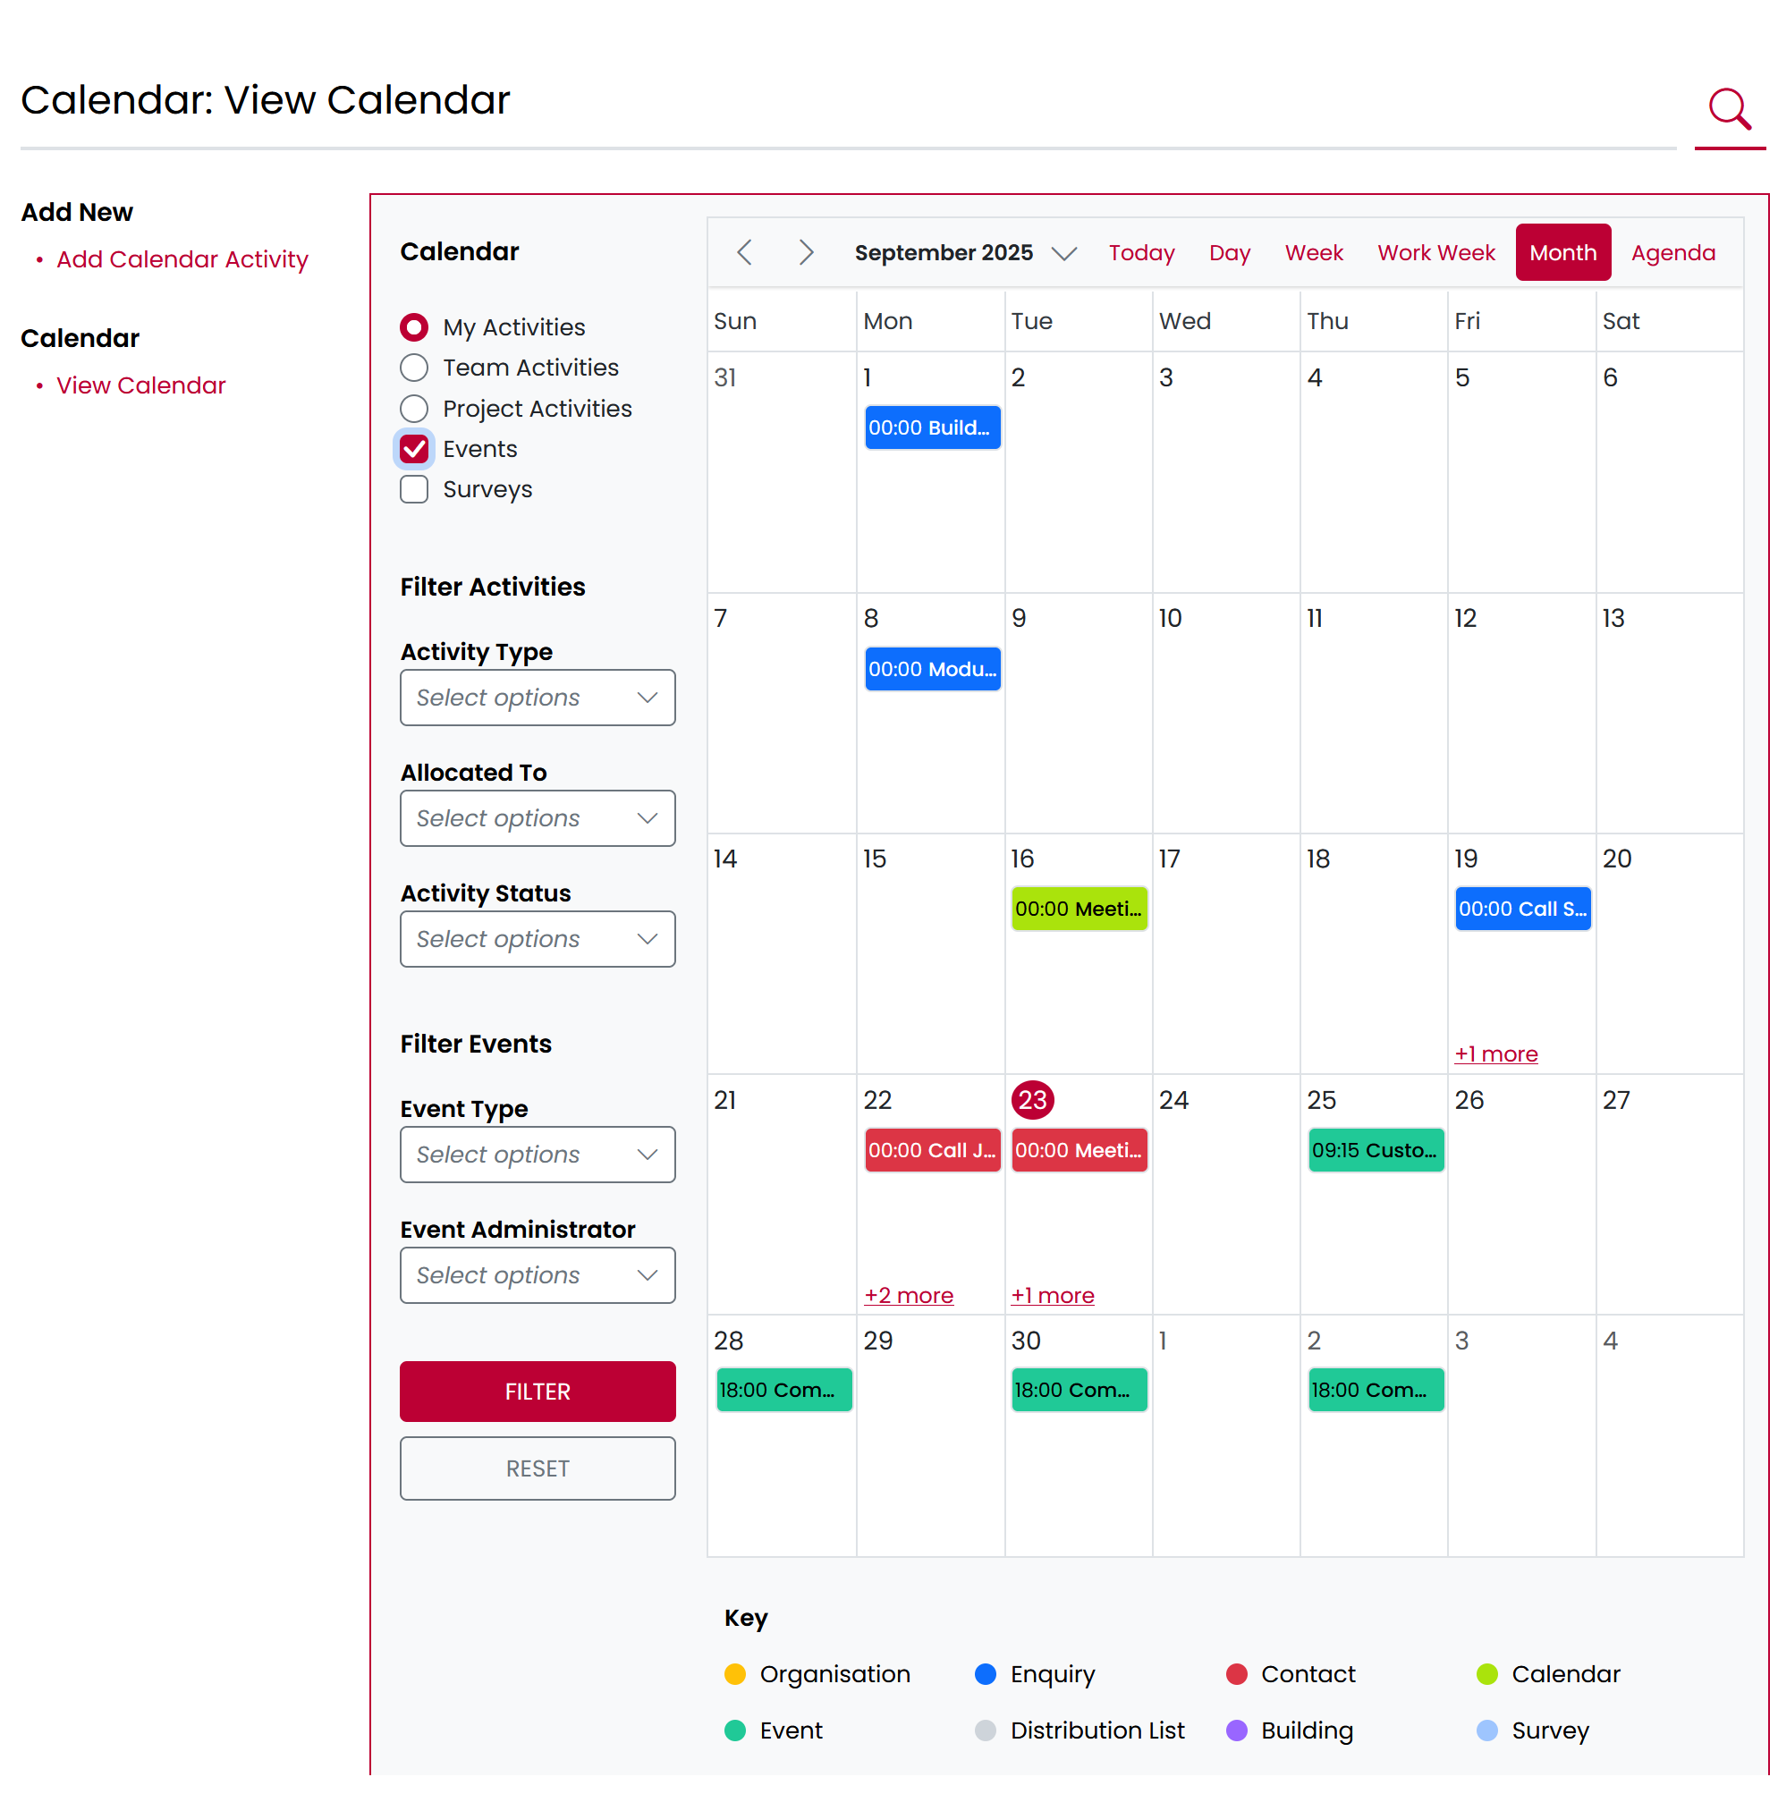
Sneak Preview – Calendar (Events)
Holistic view: Users see all engagements in one place
Avoid clashes: Helps prevent double-booking when personal or organisational events overlap
Forward planning: Teams can anticipate busy periods and plan around them.

Slide 25
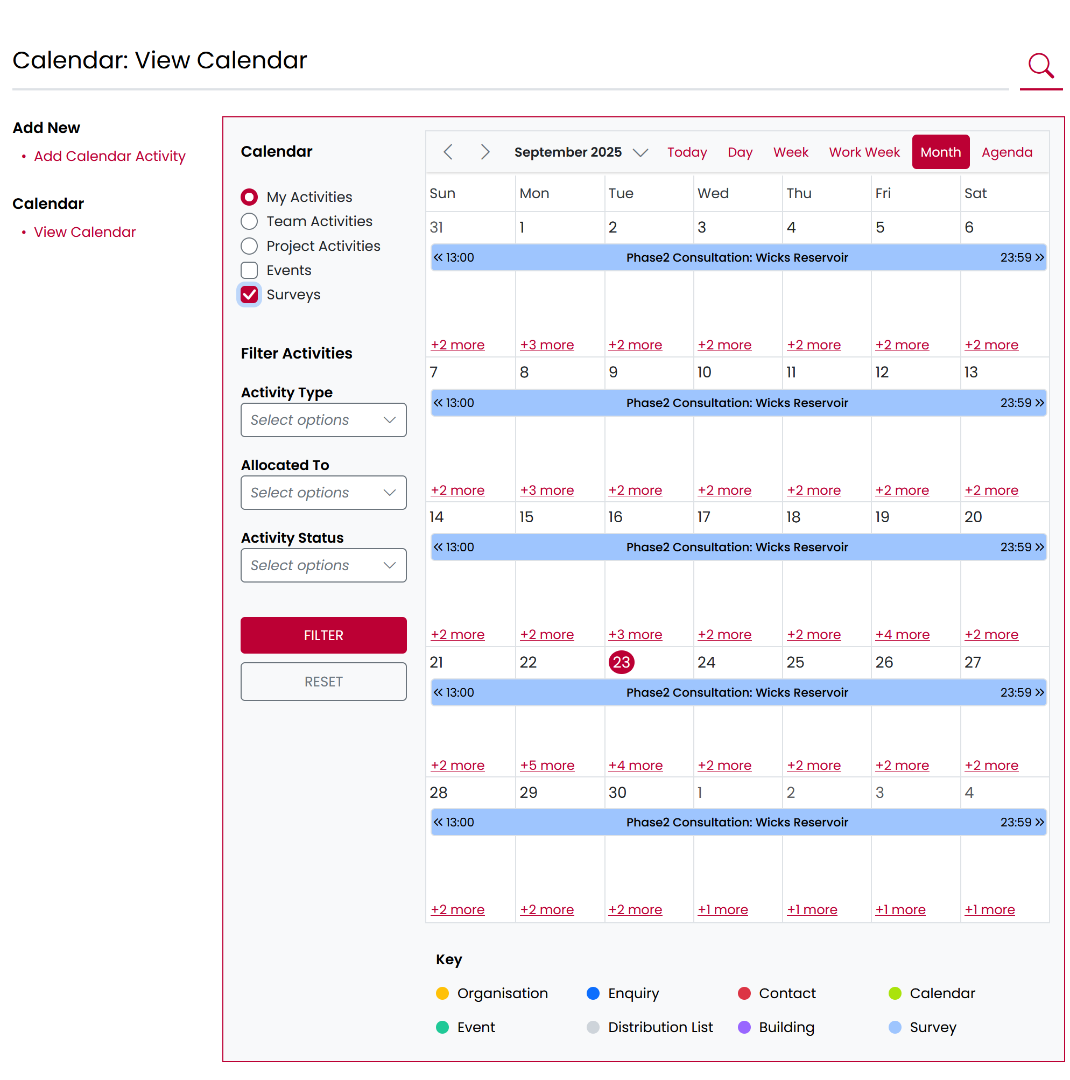
Sneak Preview – Calendar (Surveys)
Surveys included
Avoid overlaps: Helps plan survey launches around other activities, reducing audience fatigue.
Timely reminders: Start and end dates in the calendar make it easier to prepare communications and follow-up actions.

Slide 26
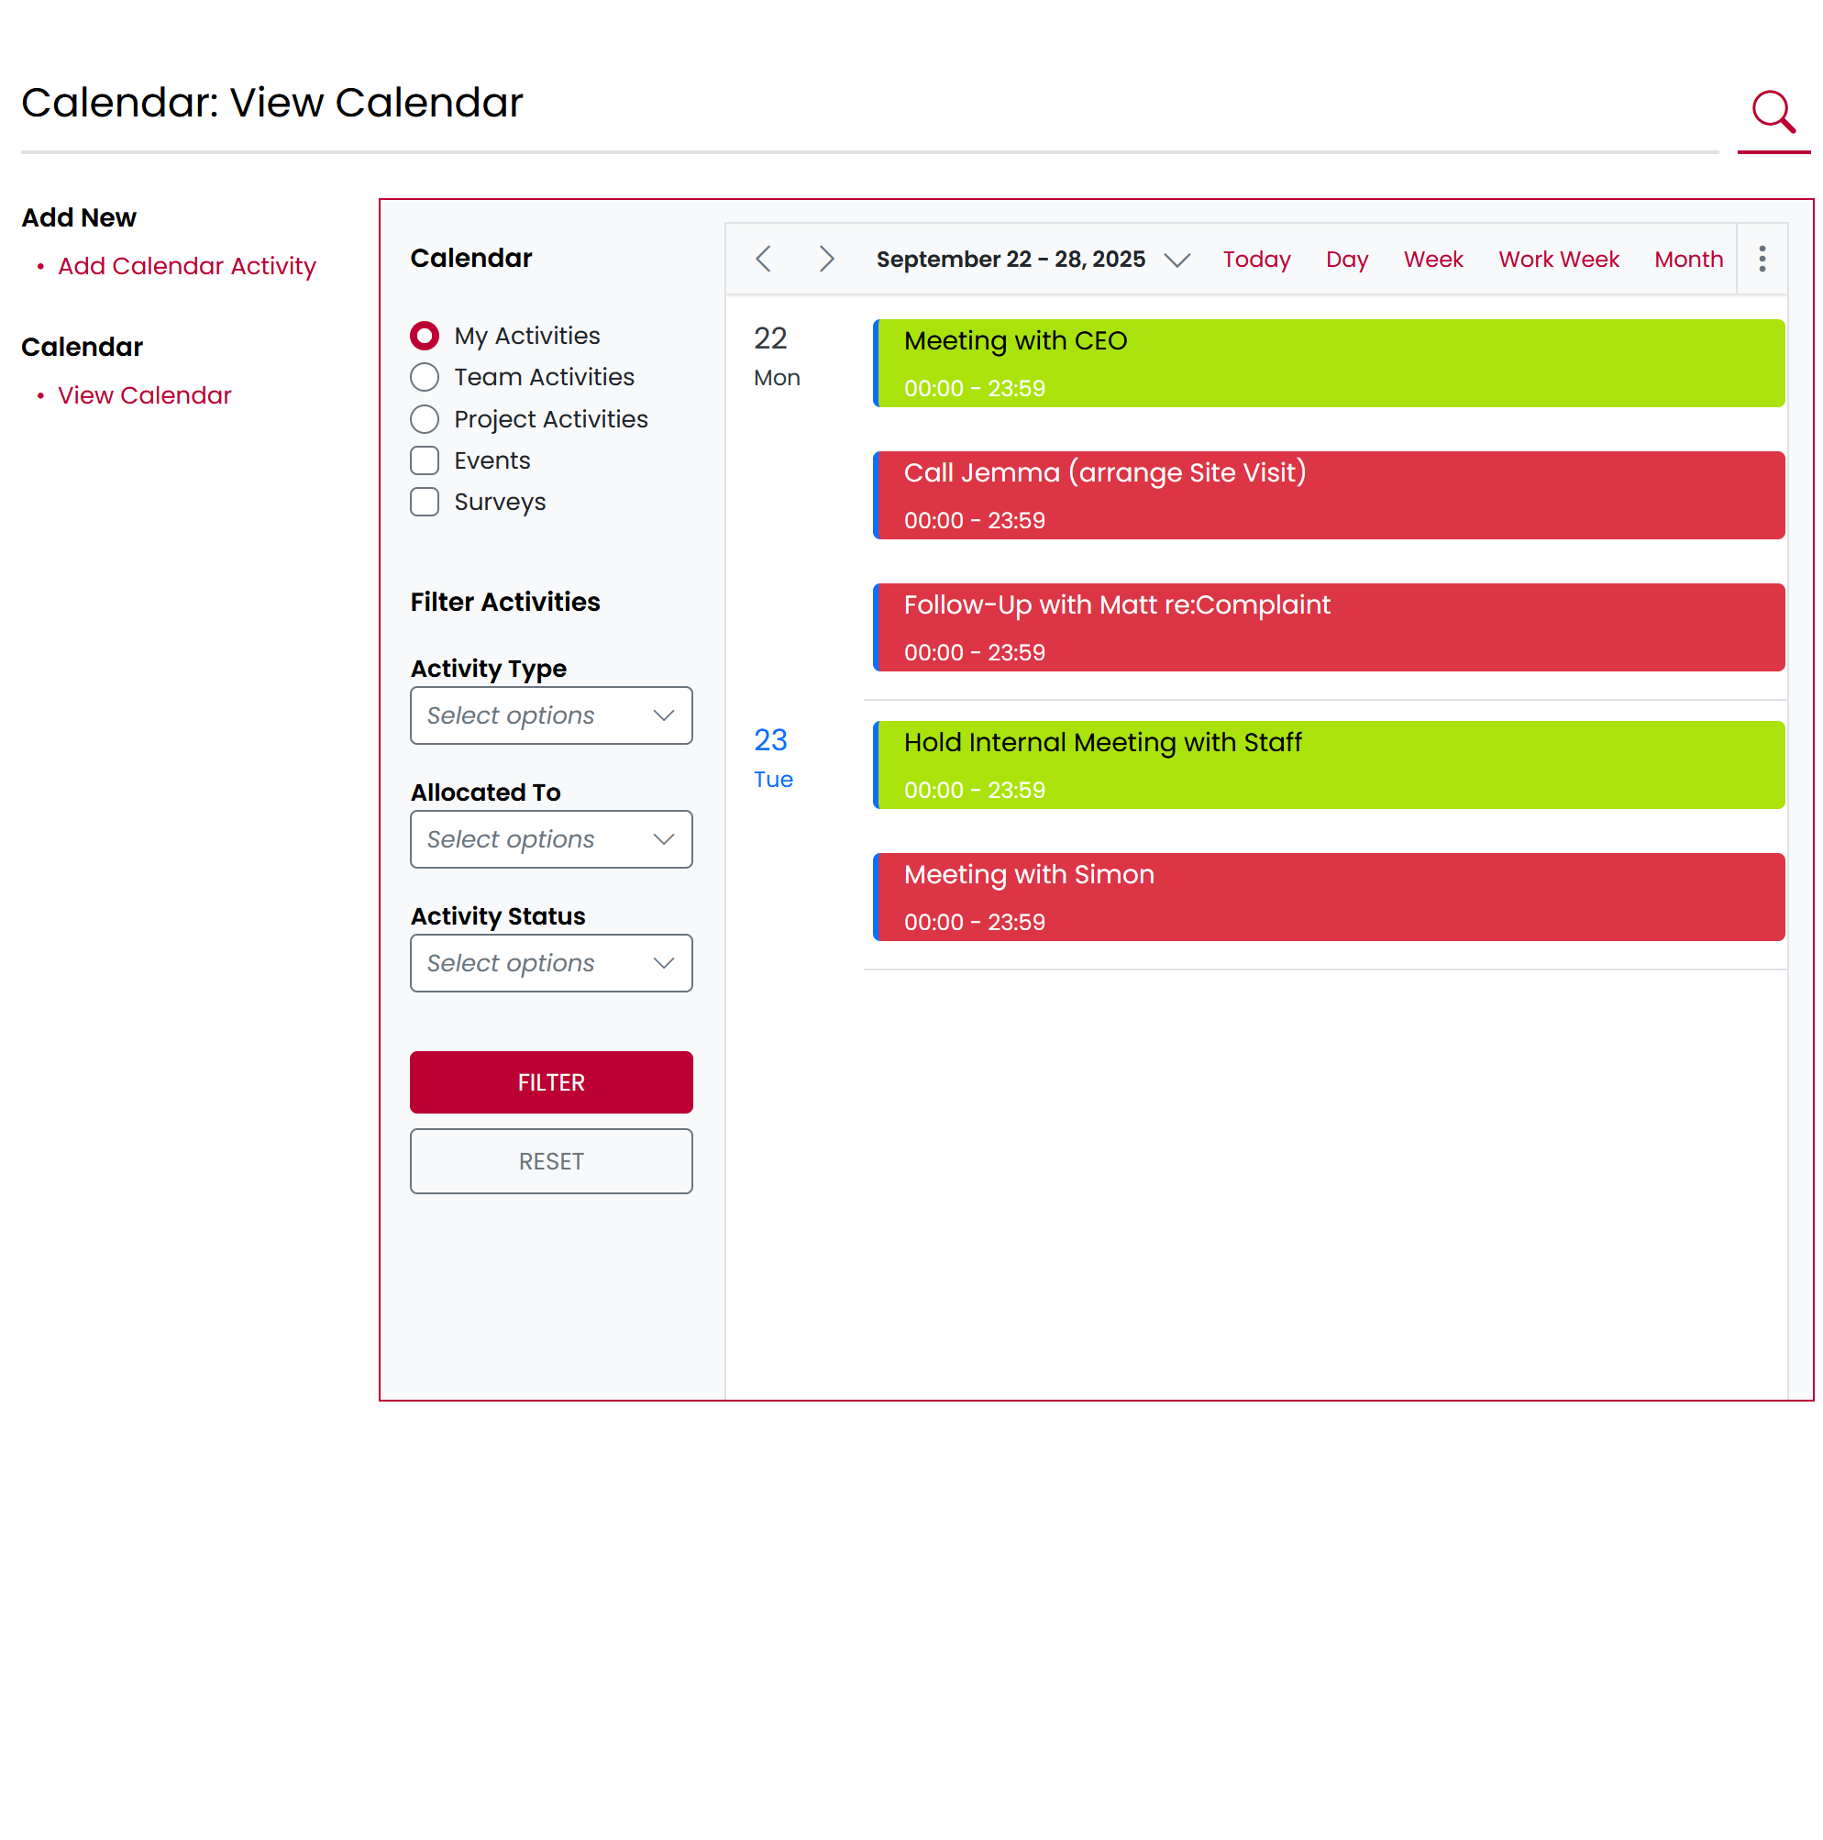
Sneak Preview – Agenda
Organisation & Time Management
Clear overview of your day: Quickly see what’s coming up and how your time is allocated
Prioritisation: Helps focus on what’s important by balancing meetings, tasks, and personal commitments.

Slide 27
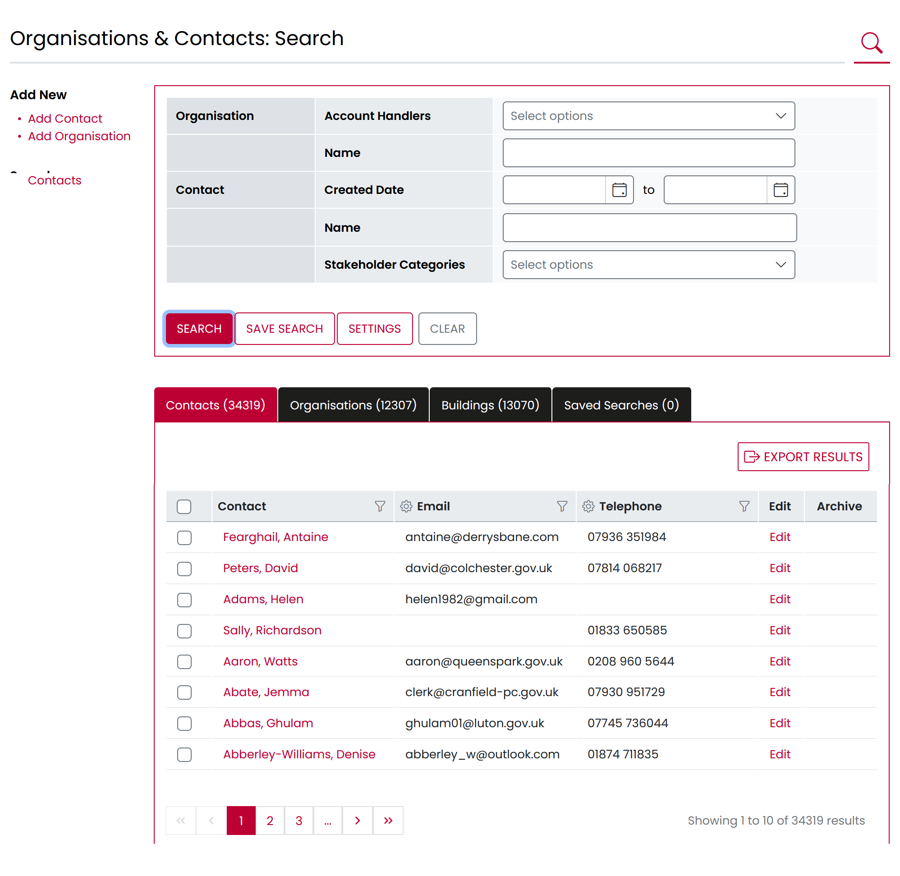
Sneak Preview – Search
Search filters grouped by Record type.
Speed Improvements
Filter & Sorting Options
Custom Column Settings remain

Slide 28
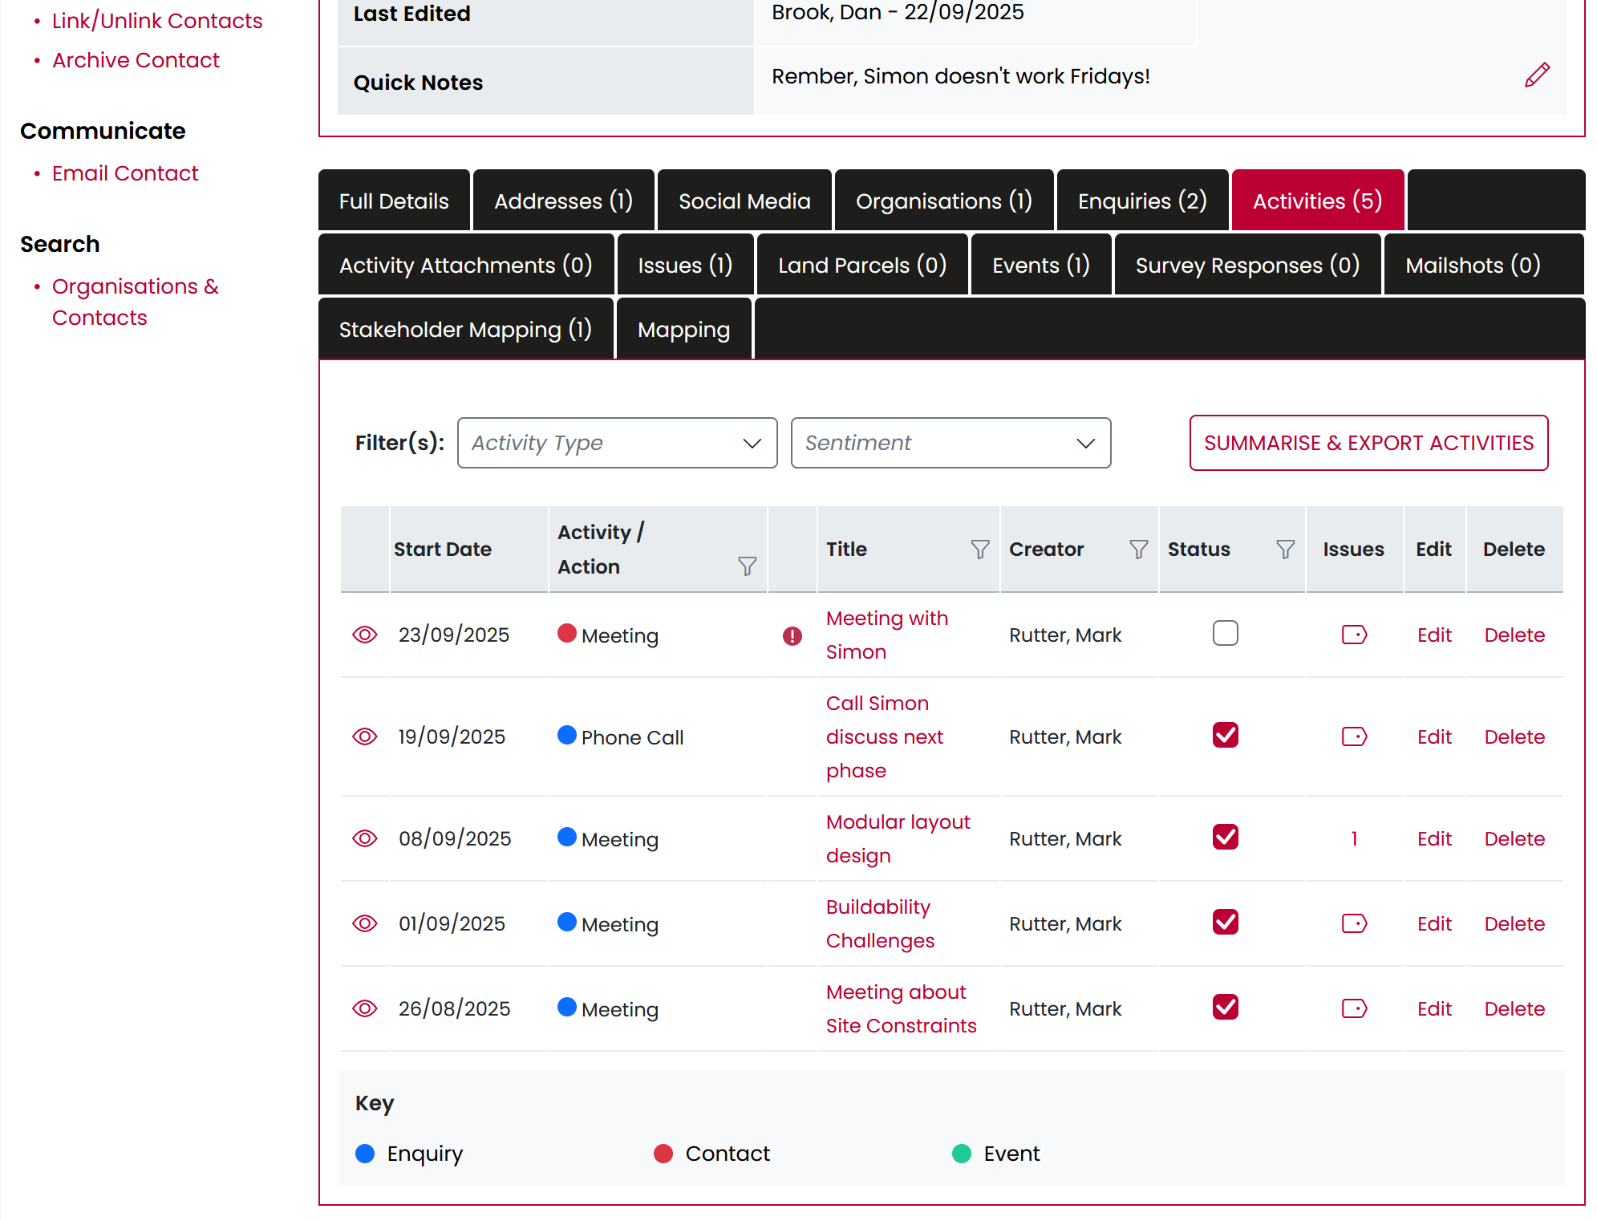
Sneak Preview – Activity Grids
Cleaner Interface: A modern, simplified layout makes navigation intuitive and reduces clutter.
Enhanced Filtering: Quickly drill down to the exact records or activities you need with smarter filters.

Slide 29
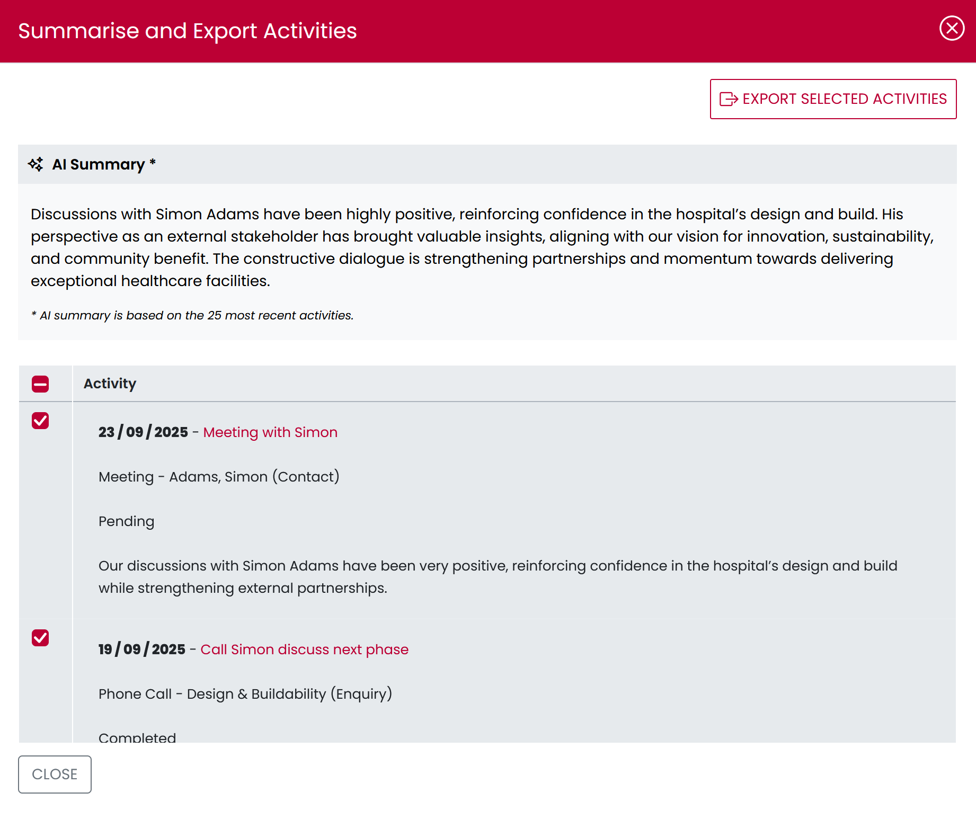
Sneak Preview – A.I. Summary
Drives Efficiency & Time-Saving: Cuts through information overload
Focus on what matters: Brings forward the most relevant discussions
Shared understanding: Ensures everyone has access to a clear, concise recap

Slide 30
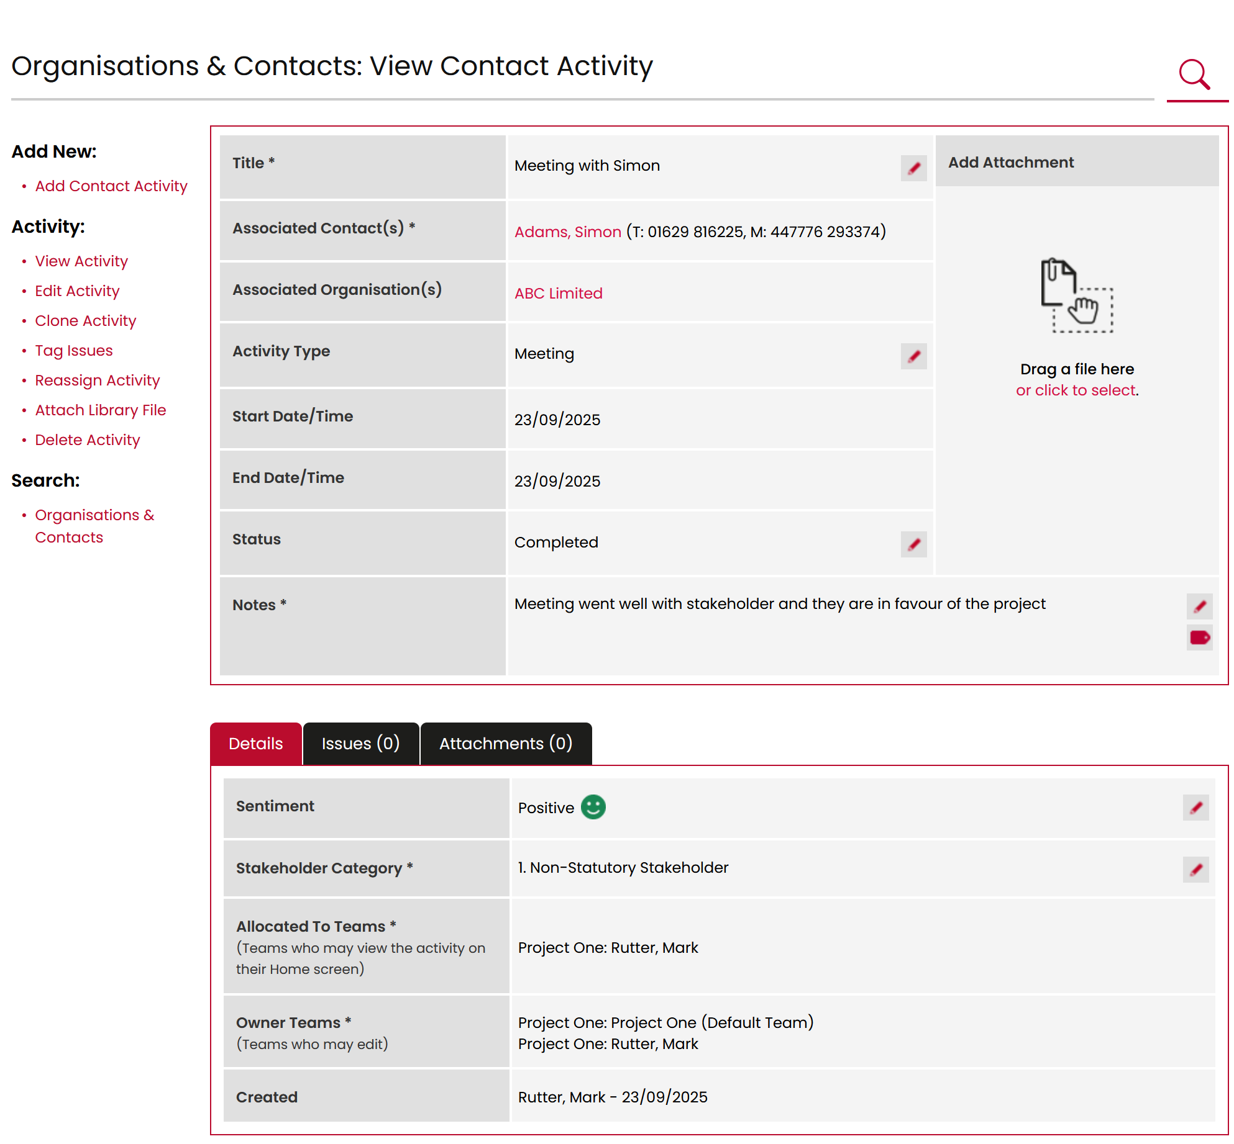
Sneak Preview – A.I. Sentiment
A.I. automatically classifies inbound emails, meetings, and calls as Positive, Negative, or Neutral.
Sentiment can be overridden anytime for accuracy by users.

Slide 31
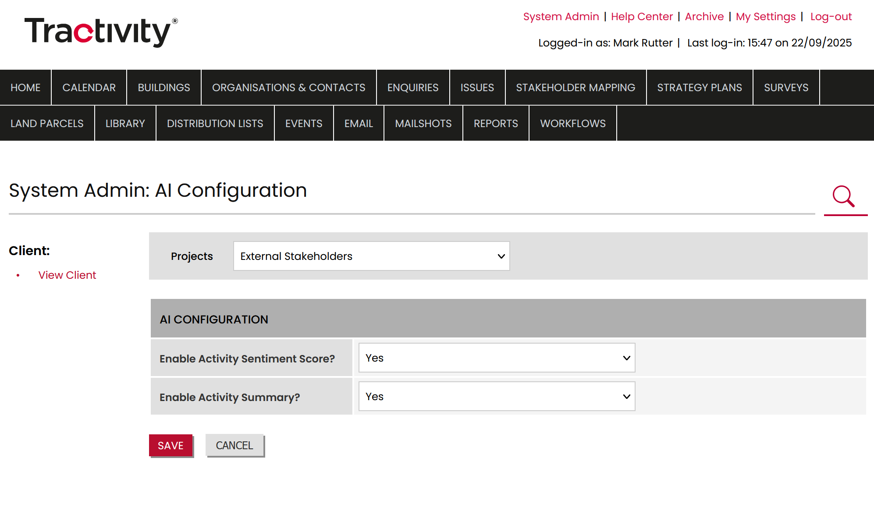
Sneak Preview – Configurable A.I. Features
All A.I.-powered functionality can be enabled or disabled through the System Admin settings
Governance & Review: Each feature is configurable, allowing IT to assess, test, and review before approval or rollout in alignment with policies

Slide 32
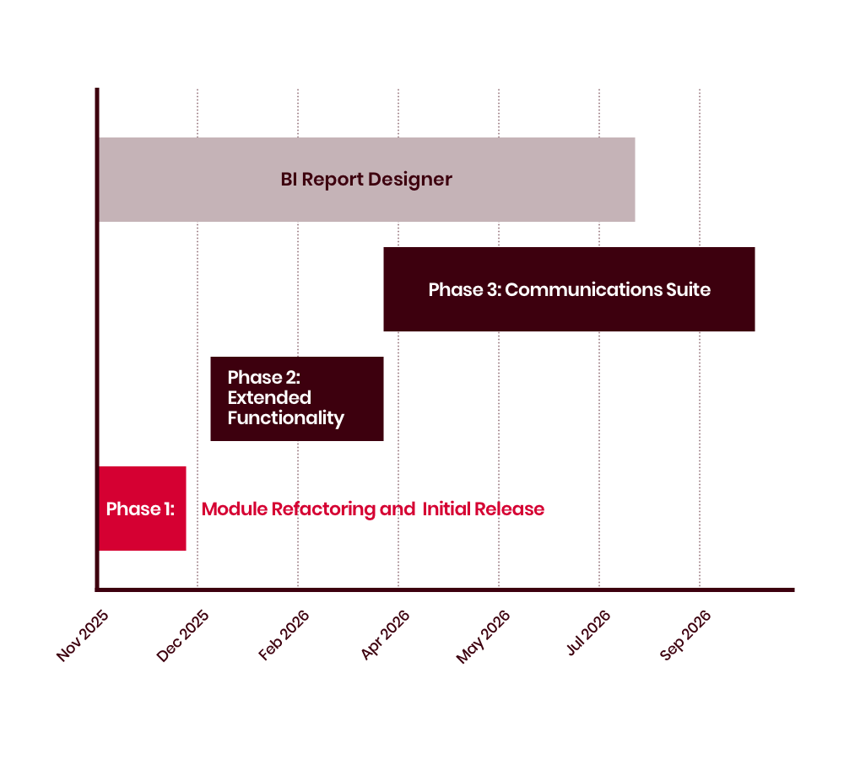
Tractivity Development Roadmap
Phase 1: Core Module Refactoring & Initial Release
Modules: Login, Home, Calendar, Organisation & Contact, Activity
Refactoring: Complete core module refactoring by late November 2025
Deployment: Early December 2025 to a small subset of clients
Stabilisation Period: 3 weeks for monitoring, and feedback before broader release blocks

Slide 33
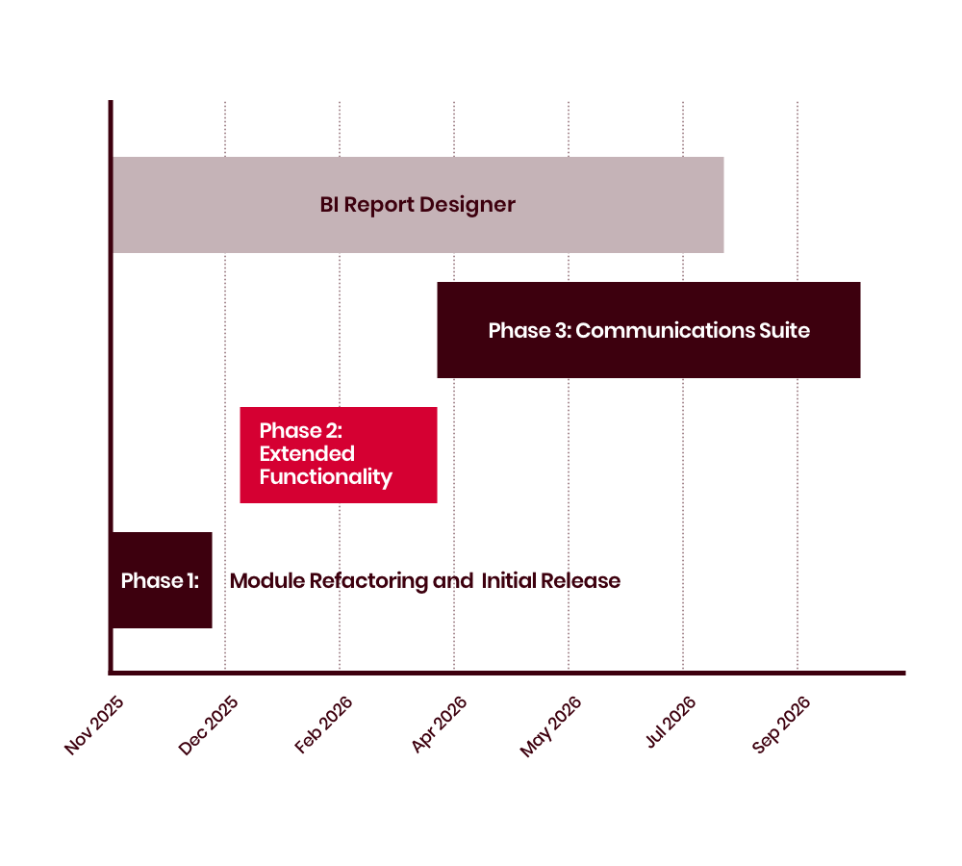
Tractivity Development Roadmap
Phase 2: Extended Functionality
Timeline: End of Q1 2026 (end of March)
Modules:
Enquiry
New Activity module
Extended Searching capabilities
Objective: Broaden feature set, enhance usability, and strengthen search-driven workflows (based on past workshop feedback)

Slide 34
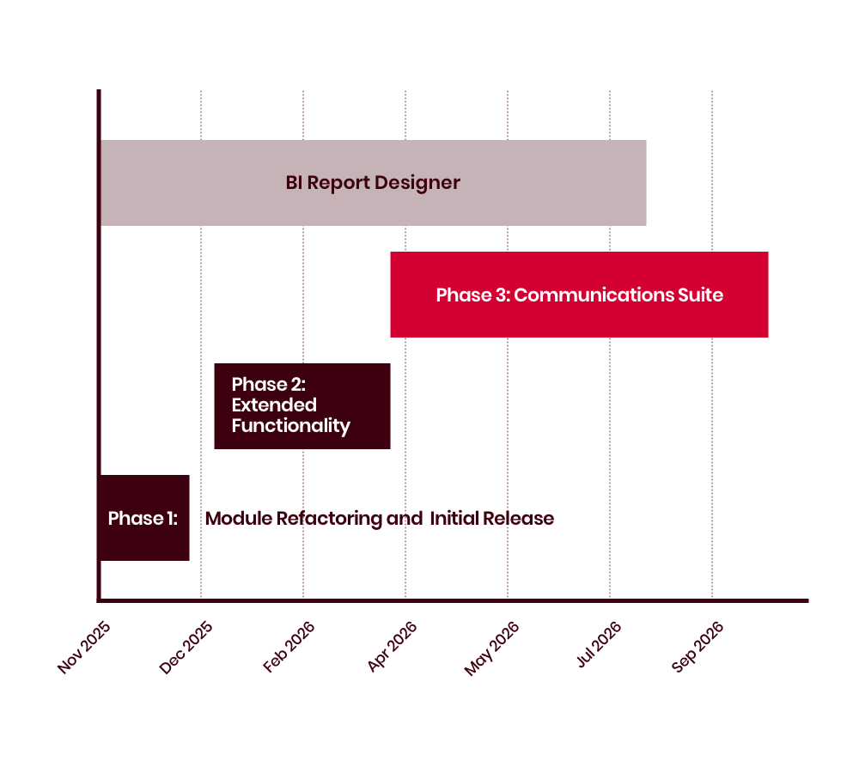
Tractivity Development Roadmap
Phase 3: Communications Suite
Timeline: Q2–Q3 2026
Modules:
Email
Newsletters
Event
Focus: Expand Tractivity into integrated communication tools, improving stakeholder engagement

Slide 35
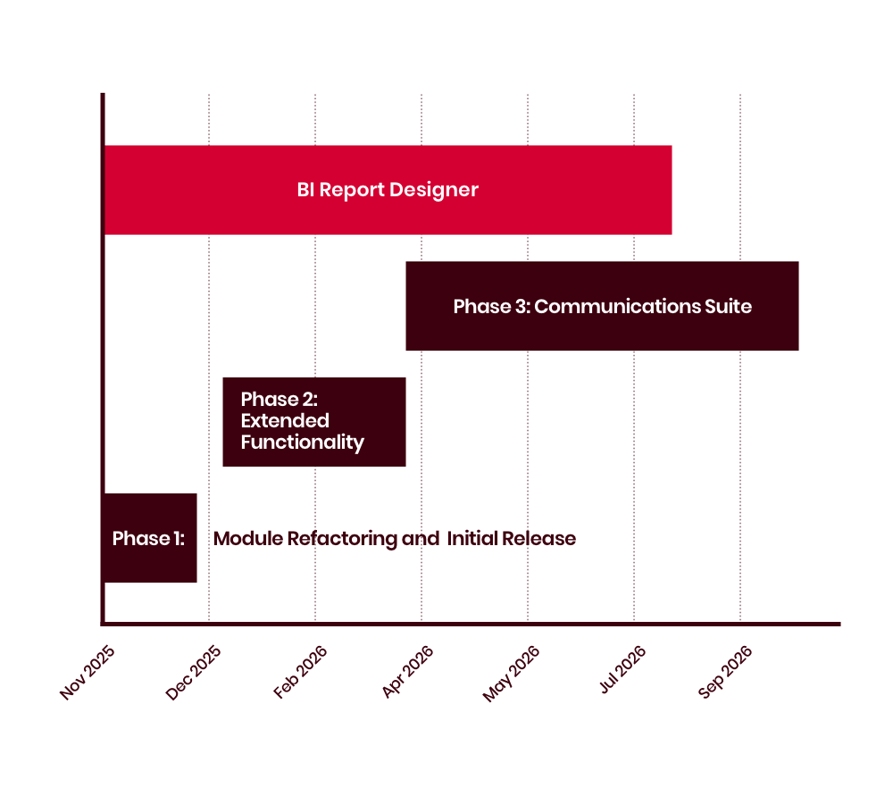
Tractivity Development Roadmap
Parallel Development Streams
Bespoke Client Requests: Delivered on demand throughout roadmap to support client-specific needs
BI Report Designer: Ongoing development work targeted at business analysts, with expected release in Summer 2026

Slide 36
Thank you & Any Questions?

